Slide 1
Sustainable & Smart Tourism
Training Program
Organized by Mekong Institute (MI)
Funded by Mekong – Korea Cooperation Fund (MKCF)
November 2023

Slide 2
Introduction of Sustainable Tourism and the Need for a Regenerative Approach
MODULE 2
Trainer
November 2023

Slide 3
Introducing Sustainable Tourism (1)
Session 2
Monday

Slide 4
Introduction to Sustainable Tourism
Definitions & Background
Historical Context
Significance of Sustainable Tourism Strategies
Interactive Discussion – Q&A

Slide 5
Introduction to Sustainable Tourism
Sustainable tourism has emerged as a vital concept in recent years, driven by the pressing need to protect our planet's natural resources and cultural heritage.

Slide 6
Importance of Sustainable Tourism
When surveyed in 2022, over 80 percent of global travelers said that sustainable tourism is important.

Slide 7
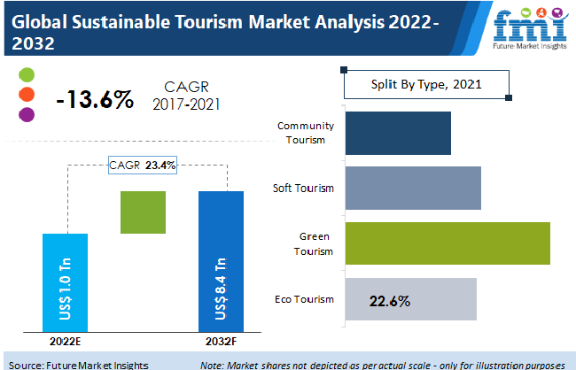
Importance of Sustainable Tourism

Slide 8
Definitions & Background
Sustainable Tourism refers to sustainable practices in and by the tourism industry. It is an aspiration to acknowledge all impacts of tourism, both positive and negative. It aims to minimize the negative impacts and maximize the positive ones.

Slide 9
Definitions & Background
'Sustainable tourism' or 'tourism in the green economy' has been defined as tourism activities that can be maintained indefinitely in their environmental, social, economic and cultural contexts and despite their effect on these areas of life (UNEP & UNWTO, 2005).

Slide 10
Definitions & Background
Sustainable tourism is defined by the UN Environment Program and UN World Tourism Organization as “tourism that takes full account of its current and future economic, social and environmental impacts, addressing the needs of visitors, the industry, the environment and host communities.” (2023)

Slide 11
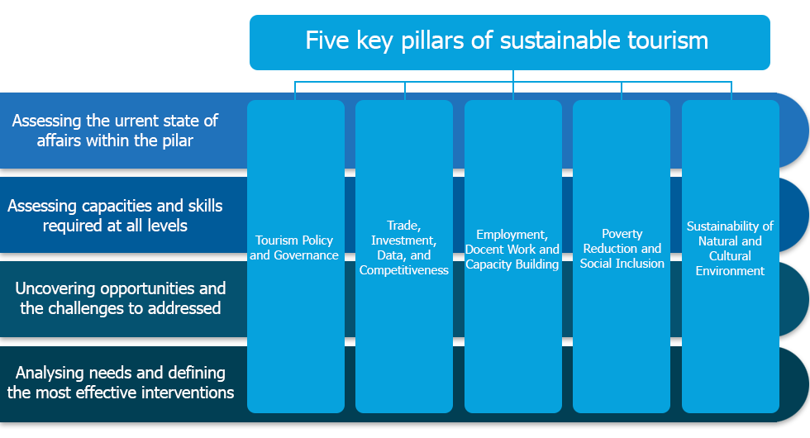
The 5 Pillars for Sustainable Tourism Development

Slide 12
Definitions & Background
Sustainable tourism is defined by the UN Environment Program and UN World Tourism Organization as “tourism that takes full account of its current and future economic, social and environmental impacts, addressing the needs of visitors, the industry, the environment and host communities.” (2023)

Slide 13
1. Alternative Tourism 2. Eco Tourism 3. Responsible Tourism 4. Green Tourism 5. Sustainable Tourism 6. Regenerative Tourism
Historical Context

Slide 14
Significance of Sustainable Tourism Strategies
On a local, regional or national level, sustainability strategies are essential to unify all stakeholders under a common long-term vision for their place.
Tourism can be a unique recourse of prosperity and well-being for the communities and for all stakeholders

Slide 15
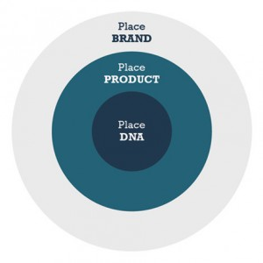
Significance of Sustainable Tourism Strategies
Each strategy must be developed according to the unique characteristic of its place.
We need to consider seriously the place DNA.
We can briefly read brief strategy statements from various organization and authorities.

Slide 16
Significance of Sustainable Tourism Strategies
Sustainable tourism strategy of Spain 2030
Objective of sustainable tourism strategy of Spain 2030
The government of Spain, through the secretariat of state of tourism, is developing the strategy of sustainable tourism of Spain 2030, a national agenda of tourism for the challenges of the sector in the medium and long term, pushing the three pillars of sustainability: socio-economic, environmental and territorial. For this, it has promoted a participatory process which involves the sector and the autonomous communities.

Slide 17
Significance of Sustainable Tourism Strategies
Sustainable tourism strategy of India
National Strategy for Sustainable Tourism
National Strategy for sustainable tourism aims to mainstream sustainability in Indian
tourism sector and ensure a more resilient, inclusive, carbon neutral and resource
efficient tourism while safeguarding natural and cultural resources.

Slide 18
Significance of Sustainable Tourism Strategies
Sustainable tourism strategy of India
National Strategy for Sustainable Tourism
National Strategy for sustainable tourism aims to mainstream sustainability in Indian
tourism sector and ensure a more resilient, inclusive, carbon neutral and resource
efficient tourism while safeguarding natural and cultural resources.

Slide 19
Discussion about Sustainability Strategies in Mekong Region

Slide 20
Q & A Thank You!

