Slide 1
Sustainable & Smart Tourism
Training Program
Organized by Mekong Institute (MI)
Funded by Mekong – Korea Cooperation Fund (MKCF)
November 2023

Slide 2
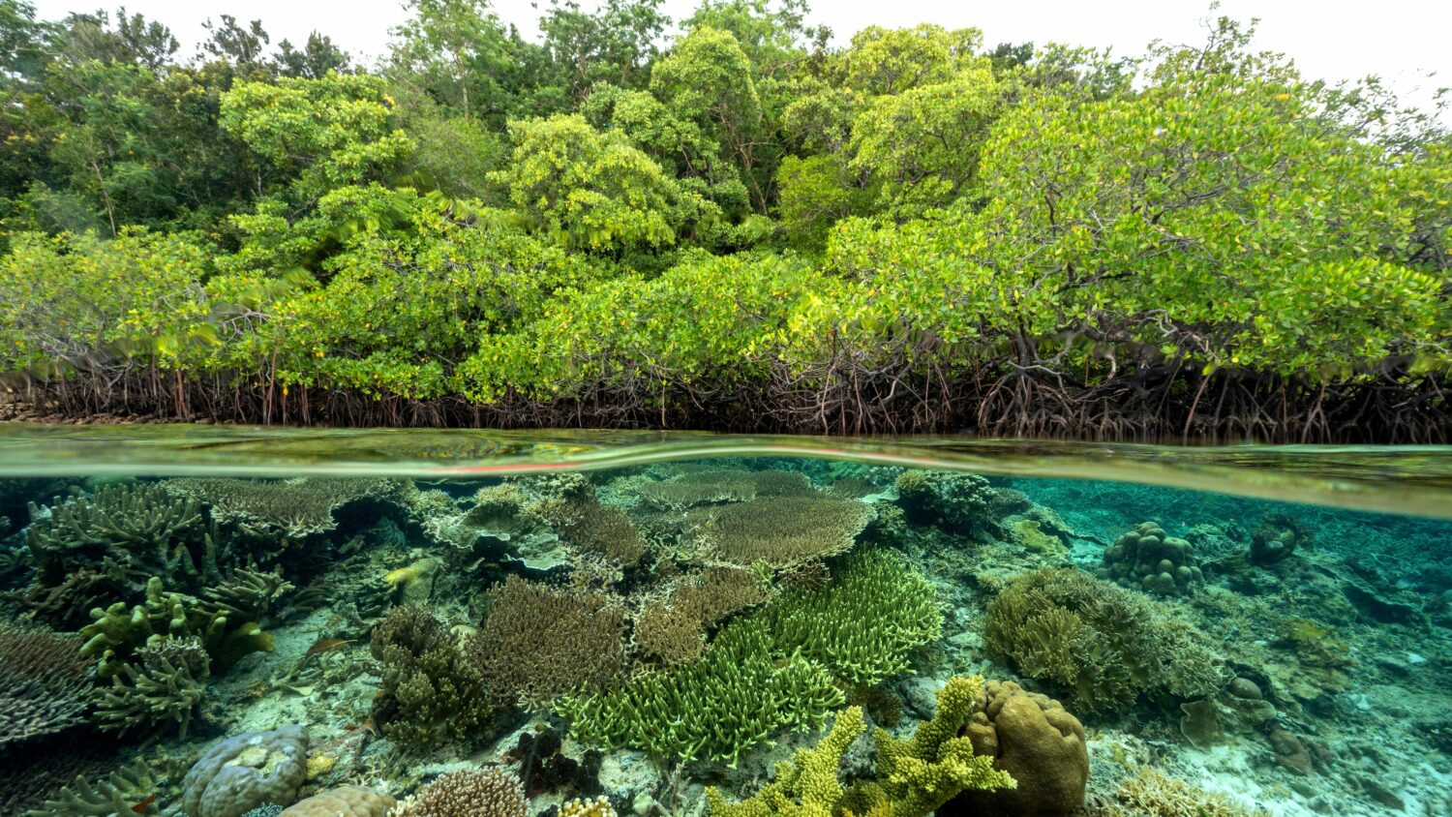


Introduction of Sustainable Tourism and the Need for a Regenerative Approach
MODULE 2
Trainer
November 2023

Slide 3
Regenerative Tourism
Session 3
Wednesday

Slide 4
Understanding Regenerative Tourism
Ecological Restoration in Regenerative Tourism
Protecting Sociocultural Values and Empowering Communities to Thrive

Slide 5
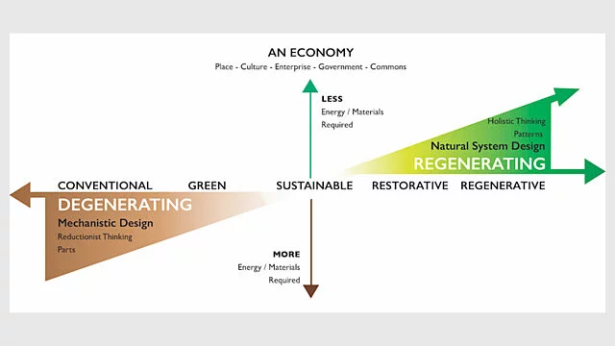
Understanding Regenerative Tourism
Regenerative tourism ensures that tourism gives back more to people and places than it takes. Tourism must add more than only economic value, it must actively enrich our communities and help protect and restore our environment.

Slide 6
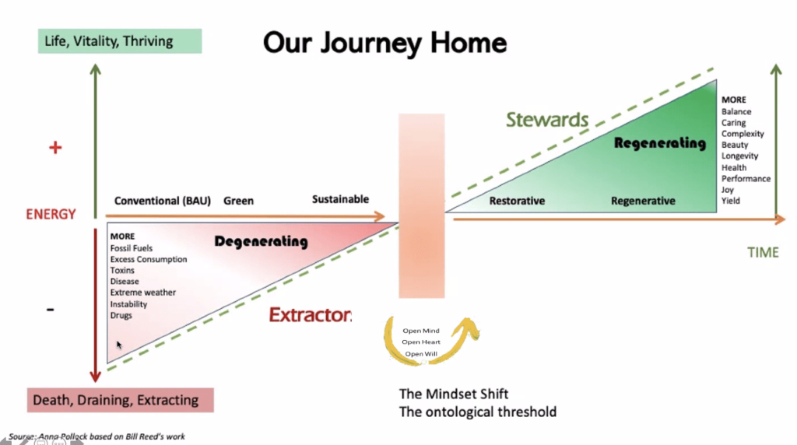
Understanding Regenerative Tourism

Slide 7

Understanding Regenerative Tourism
Beyond Sustainability
Valuing Ecosystem Function higher than material things is the paradigm shift that determines whether we understand the meaning of our lives and survive or whether we remain ignorant and selfish and destroy our own habitat trying to gain more wealth or more power. If we reach this level of understanding, not only can everyone live on the Earth but the natural systems on Earth can reach their optimal ability to sustain life.
— John D. Liu (2016)

Slide 8
Understanding Regenerative Tourism
Beyond Sustainability
"Sustainability" implies a state of balance, of maintaining what is already present without causing further damage. But we have already crossed numerous environmental boundaries. Our climate is changing at an unprecedented rate, biodiversity is decreasing, and our soils are degraded. Simply put, we missed the sustainability boat. (Paul Hawken)
“Sustainability is about survival. The goal of sustainability is to find a way to live that doesn't cause harm to anything else. But we are way past sustainability.”

Slide 9
Understanding Regenerative Tourism
Beyond Sustainability
A regenerative culture encompasses everything from regenerative agriculture, which restores soil health and biodiversity, to regenerative economics, which aims to circulate wealth in equitable, inclusive ways. It encompasses social regeneration too, building resilient communities that can adapt to change and are fair and inclusive.
It is about evolving consciously, learning from nature and traditional indigenous knowledge, and creating systems that benefit all forms of life.

Slide 10
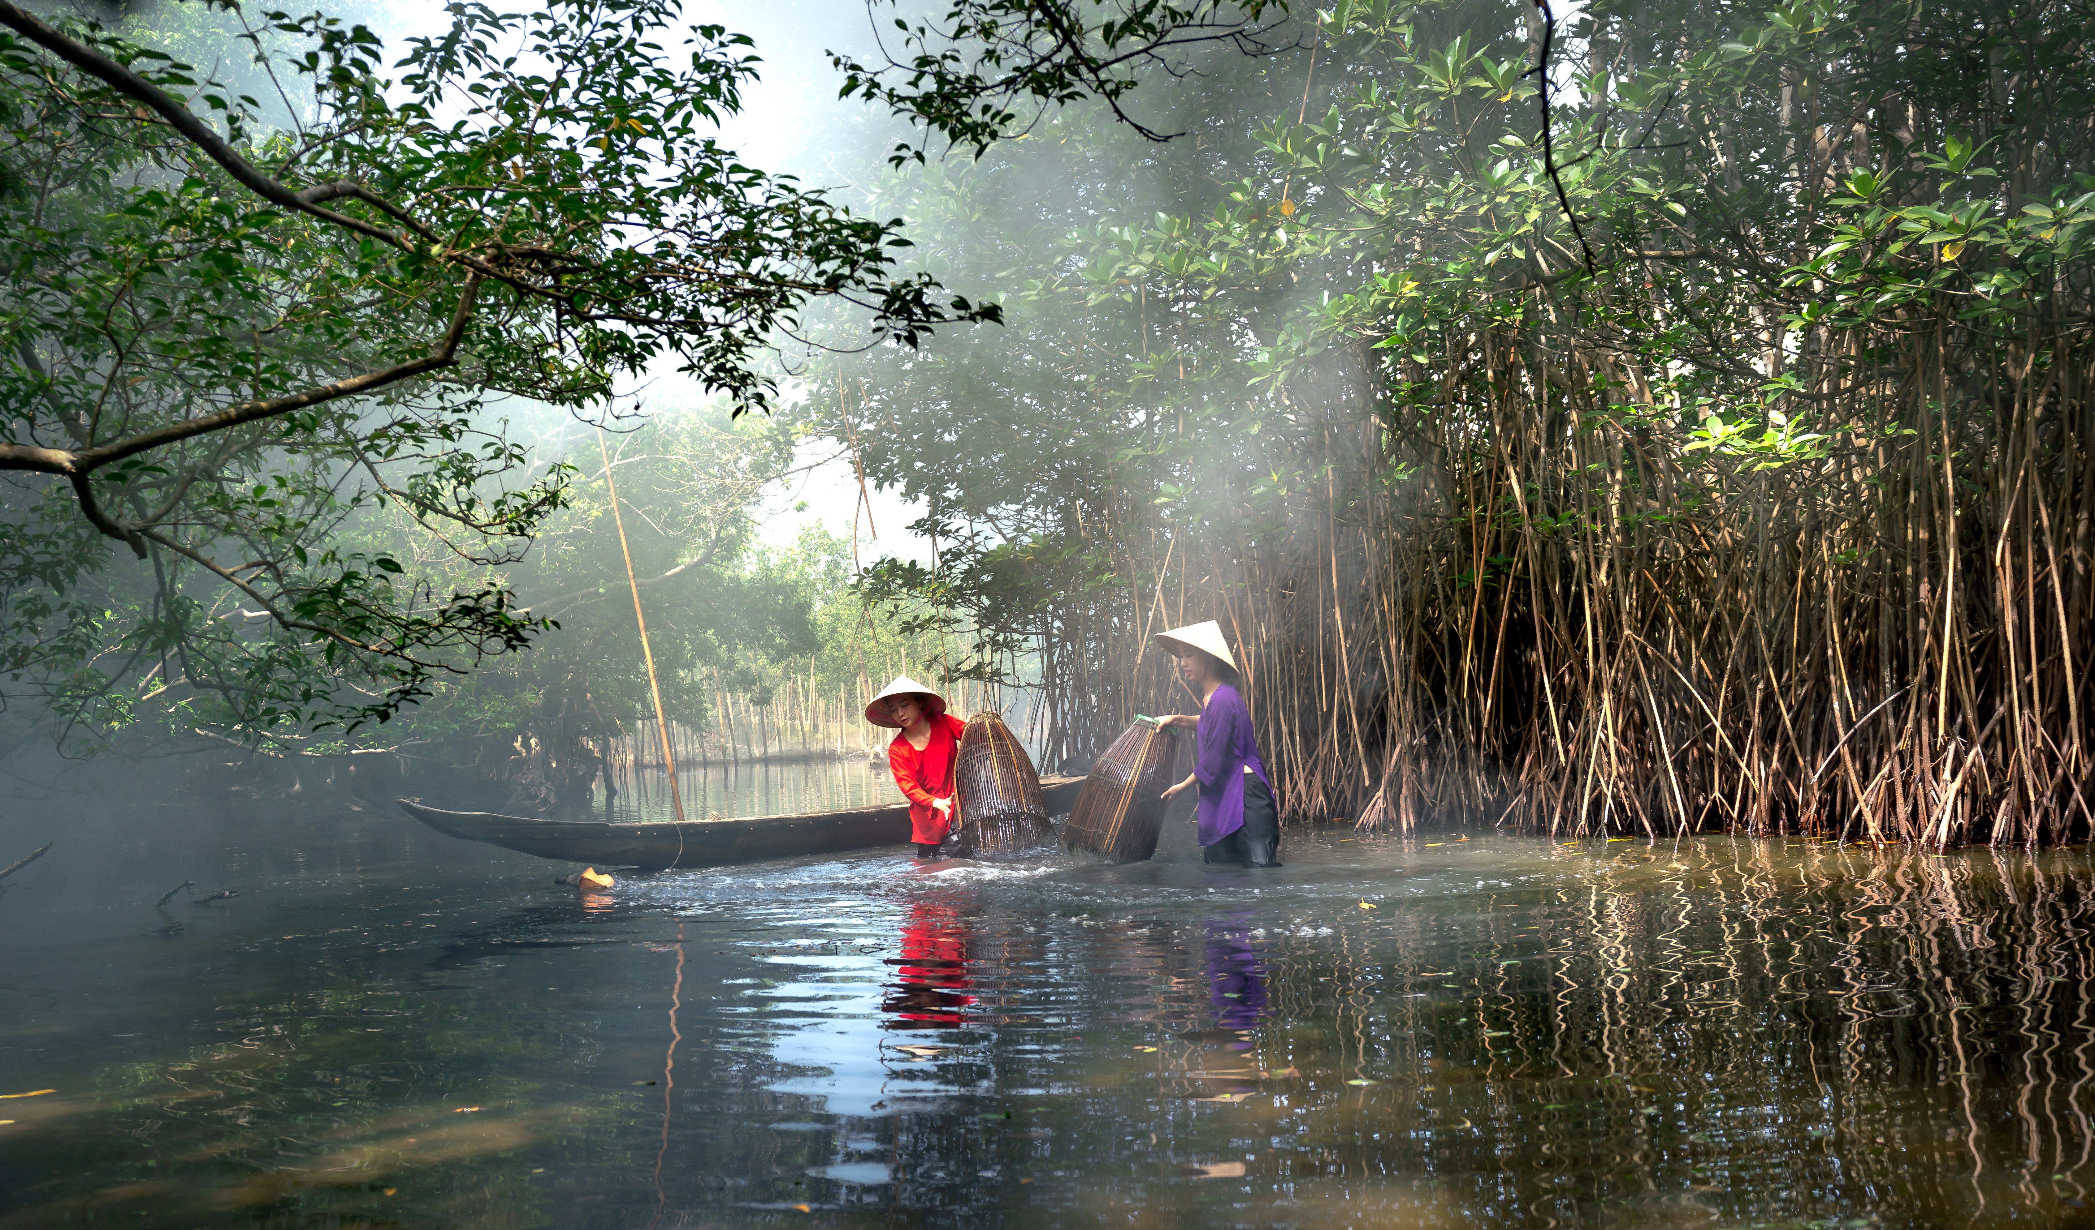
Ecological Restoration in Regenerative Tourism
Ecological restoration
It is the process of assisting the recovery of an ecosystem that has been degraded, damaged, or destroyed to reflect its intrinsic values and to provide goods and services that people value. The aim is to return the ecosystem to the condition it would have been in if degradation had not occurred, accounting for anticipated change.

Slide 11

Ecological Restoration in Regenerative Tourism
Ecological restoration
Regeneration is usually used as a synonym for restoration, but it is slightly different as in its meaning it also considers design and economic approaches.
The origin of the term comes from the scientific and biological world, where “regeneration” is used to describe the ability of some organisms to recreate certain parts of their bodies after being damaged. This ability is called “regenerative capacity”.

Slide 12
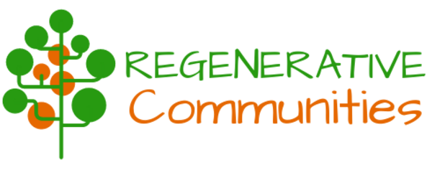
Protecting Sociocultural Values and Empowering Communities to Thrive
Why Creating Regenerative Cultures?
The short answer to why we should aim to create regenerative cultures together is simple: choosing the path of regeneration and cooperation will create a greater level of wellbeing, health, happiness and equality for everyone and all life; and in the process of co-creating a better future together, our lives will be more meaningful, fulfilling, creative and fun.

Slide 13
Protecting Sociocultural Values and Empowering Communities to Thrive
Why Creating Regenerative Cultures?
There is a wave of change manifesting a more thriving world, including people living or longing to live in community, in closer relationship with the rest of life.
Regenerative Community Development, based on life’s and nature’s principles, provides a viable path toward that more thriving world and toward successful intentional communities.

Slide 14
Protecting Sociocultural Values and Empowering Communities to Thrive
Empowering Local Communities?
Regenerative Communities are collaborating with local social impact organizations to create a new Collaborative Governance Model.
Bringing together communities using a holistic approach to foster collective wellbeing, increasing potential for rural and regional towns to thrive.

Slide 15
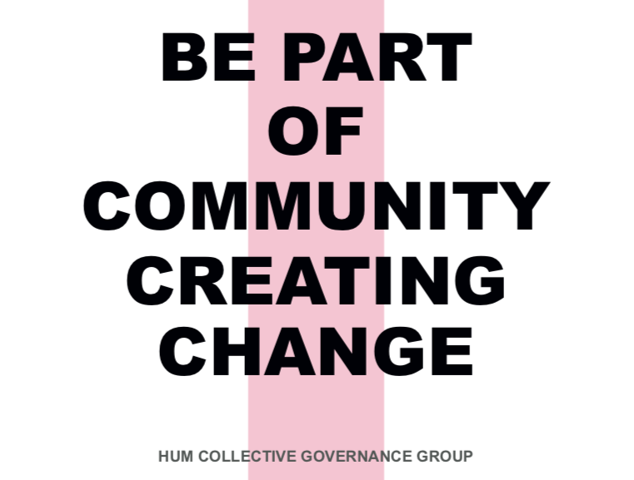
Protecting Sociocultural Values and Empowering Communities to Thrive
Empowering Local Communities
Discussing Cases of Regenerative Communities
A new Collaborative Governance Model for HUM
(Australia)

Slide 16
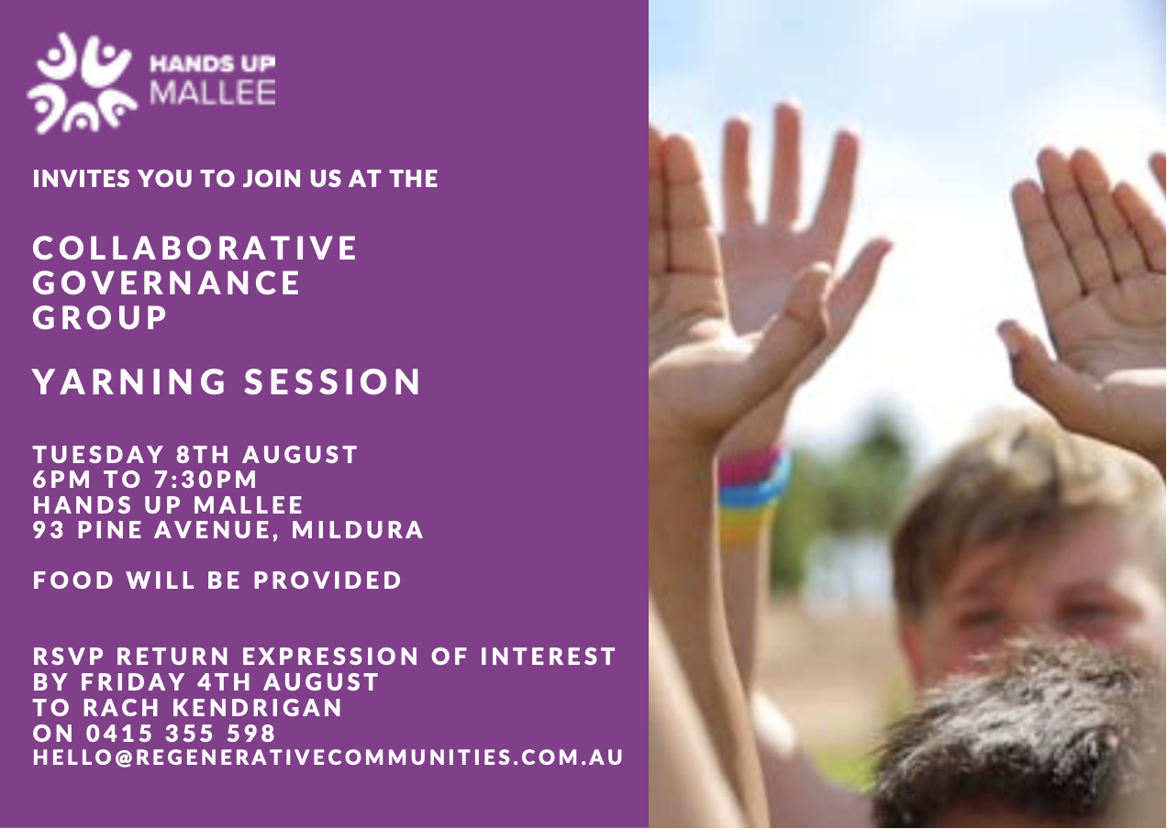
Discussion about Regenerative Communities

Slide 17
Q & A
Thank You!

