Slide 1
Sustainable & Smart Tourism
Training Program
Organized by Mekong Institute (MI)
Funded by Mekong – Korea Cooperation Fund (MKCF)
November 2023

Slide 2
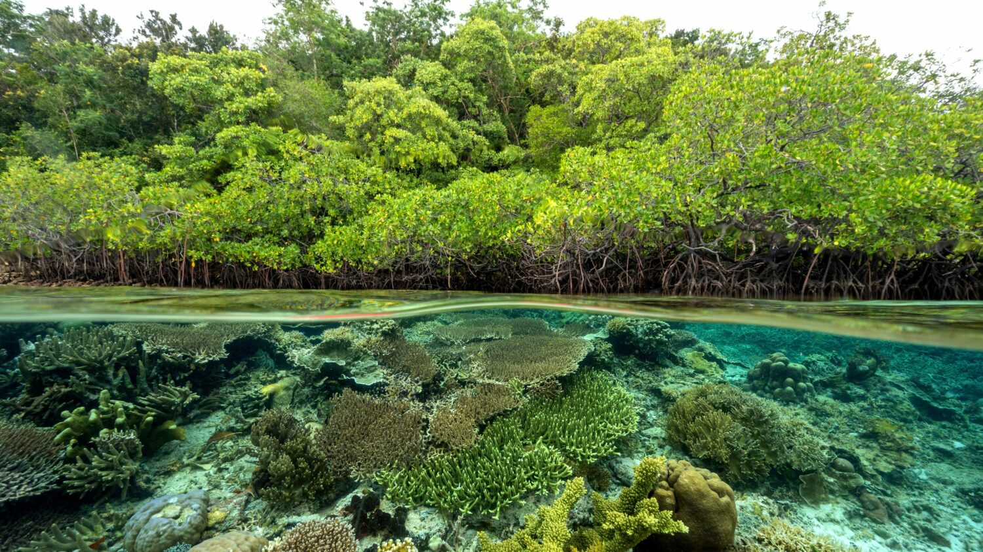


Introduction of Sustainable Tourism and the Need for a Regenerative Approach
MODULE 2
Trainer
November 2023

Slide 3
Regenerative Tourism (2)
Session 4

Slide 4
Embracing Inclusivity in Tourism
Elevating Well-Being
Empowering Local Stakeholders and SME’s

Slide 5

Embracing Inclusivity in Tourism
Tourism for All – Inclusive Tourism
Tourism can Promote stable, inclusive and qualified jobs as well as social security benefits for all.
Regional actors should help destinations to become more inclusive, responsible, attractive and competitive. This entails the use of certifications, labels and ethical codes to ensure proper social, economic and environmental performance, best-in-class market value and good reputation, compared with traditional business models.

Slide 6

Embracing Inclusivity in Tourism
Tourism for All – Inclusive Tourism
The social and physical accessibility, affordability and inclusion of all kinds of visitors shall be guaranteed, so as to extend customers bases and improve the ethical footprint.
The destinations should enhance differentiation, competitiveness and diversification of their products and services through investments in innovation and R&D.

Slide 7

Embracing Inclusivity in Tourism
Bridging Social & Economic Gaps
Global economic integration has been a source of prosperity for many years, but is coming under growing political pressure partly due to uneven sharing of the benefits of growth. It is perceived as one of the causes of increased inequalities and a source of disempowerment for individuals and communities. (OECD)

Slide 8

Embracing Inclusivity in Tourism
Bridging Social & Economic Gaps
To improve the opportunities of the next generation we must address the unequal outcomes of current generations.
Addressing the spatial dimension of inequalities between urban and rural areas would have a great impact on reducing overall inequalities.

Slide 9
Elevating Social Well-being
Sustainability & Social Well-being
Social sustainability aims to create inclusive societies, reduce inequality, and ensure long-term well-being for all people while preserving social cohesion and justice.
Sustainable tourism development supports and ensures the economic, social and cultural well being of the communities in which tourism takes place. (UNESCO)

Slide 10
Elevating Social Well-being
Sustainability & Social Well-being
Elevating Social Well-being needs responsible approach in various areas
- Income and Revenues
- Employment
- Strengthening of the local economy and of long-term economic viability
- Improvement of living conditions
- Participation and local control
- Satisfaction with Tourism
- Strengthening of social and cultural patterns

Slide 11
Empowering Local Stakeholders and SMEs
Sustainability & Local Stakeholders
Stakeholders are vital to the implementation of a sustainability strategy and are essential partners in achieving sustainability goals.
Stakeholders play a critical role in sustainability. Why? Because an ESG strategy requires management systems for risk and performance improvement. And stakeholders are a central component of risk management.

Slide 12
Empowering Local Stakeholders and SMEs
Sustainability & SMEs
By conducting stakeholder engagement and sentiment monitoring you will be able to identify and prioritize environmental and social issues that must be addressed, as well as develop solutions that meet their needs.
Additionally, stakeholders can serve as a powerful force for change within an organization. They can help to raise awareness of sustainability issues and encourage others to get involved in the effort.

Slide 13

Empowering Local Stakeholders and SMEs
Sustainability & SMEs
Sustainable development in SMEs can be defined as the concept and practice undertaken by small, micro-, or medium-sized businesses which embraces business conducted in a socially responsible manner with regard to the way they relate to local and global social, environmental, and economic issues.

Slide 14

Empowering Local Stakeholders and SMEs
Sustainability & SMEs
The concept of sustainability engagement goes beyond passive awareness or superficial gestures. It encompasses the active participation and involvement of SMEs in promoting and adopting sustainable practices.
This approach seeks to raise awareness, encourage action, and motivate SMEs to genuinely integrate sustainable behaviors into their daily operations.

Slide 15
Empowering Local Stakeholders and SMEs
Sustainability & SMEs – Successful Cases
The Business Case for Sustainability in Malaysian SMEs
SMEs in Malaysia are vital to the country’s economy, accounting for 38.3% of the gross domestic product (GDP) and employing nearly 70% of the labour force. Consequently, SMEs are crucial to achieving Malaysia’s SDGs, which aim to strike a balance between economic growth and social and environmental sustainability.

Slide 16
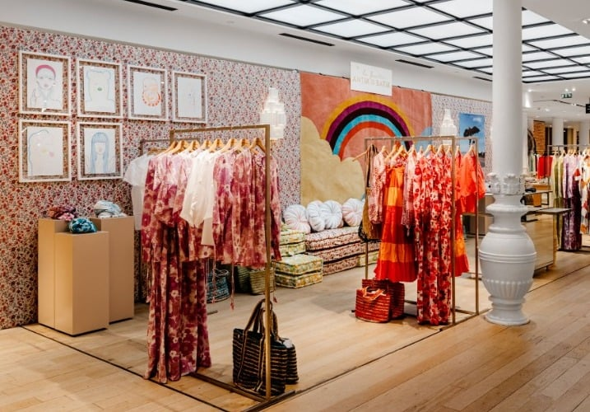
Empowering Local Stakeholders and SMEs
Sustainability & SMEs – Successful Cases
Batik Boutique is a social enterprise that provides training and employment opportunities to women from low-income communities while producing high-quality batik products. The company’s production process utilises natural dyes and recycled materials, and it has won multiple sustainability awards.
Batik Boutique’s products are popular with customers who appreciate the social and environmental benefits of the company’s operations.

Slide 17

Empowering Local Stakeholders and SMEs
Sustainability & SMEs – Successful Cases
The Hive Bulk Foods is a zero-waste grocery store that provides an extensive selection of unpackaged, organic, and locally sourced food items. The store encourages customers to bring their own containers and offers reusable packaging for those who require it. The Hive Bulk Foods has been recognized for its innovative business model and a number of sustainability awards.

Slide 18
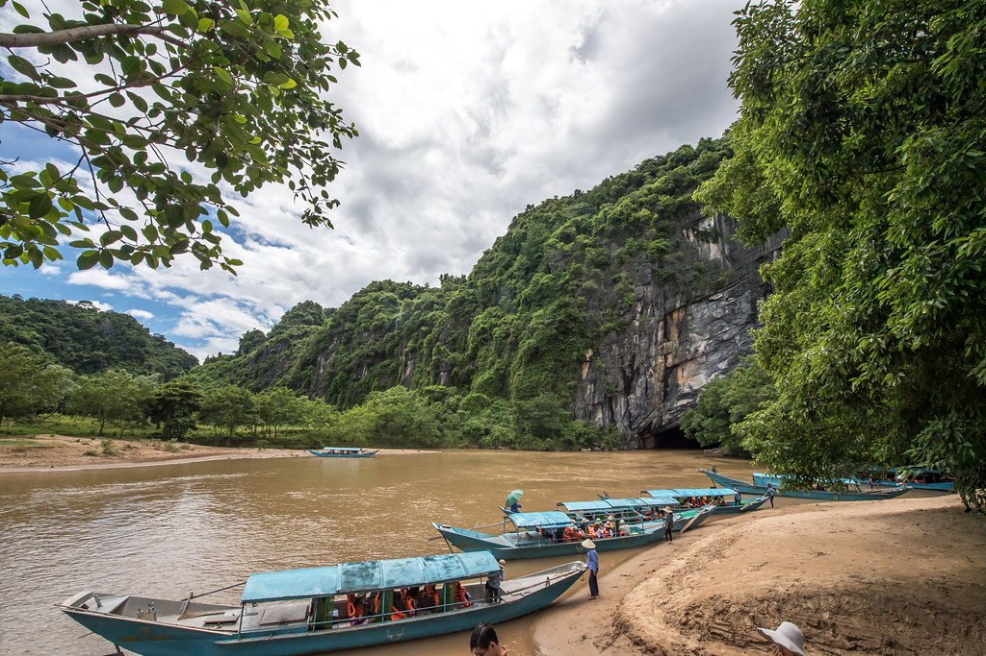
Discussion about Inclusivity & SMEs in Mekong Region

Slide 19
Q & A
Thank You!

