Slide 1
Sustainable & Smart Tourism
Training Program
Organized by Mekong Institute (MI)
Funded by Mekong – Korea Cooperation Fund (MKCF)
November 2023

Slide 2

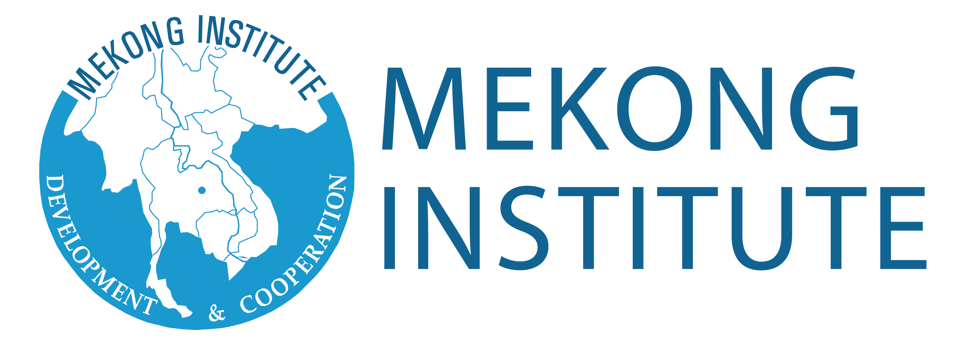

Understanding the Tourism Value Chain and the Tourism Ecosystem through System Thinking
MODULE 1
Trainer
November 2023

Slide 3
Developing Supply Chains
Session 4
Monday

Slide 4
DMO Development & Stakeholders’ Integration
Circular Economy
Developing the supply chain in line with socio-cultural and environmental criteria
Integrating Digital transformation

Slide 5
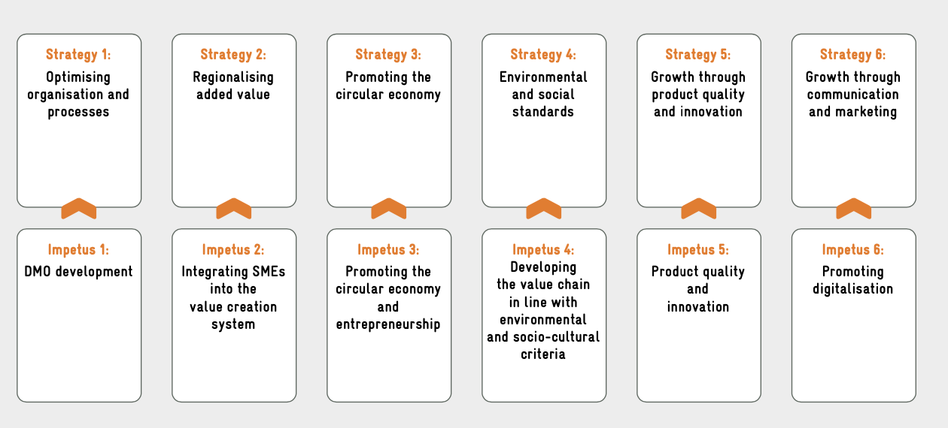
DMO Development & Stakeholders’ Integration
Value creation strategies and entry points for development cooperation to promote regional tourism value added

Slide 6
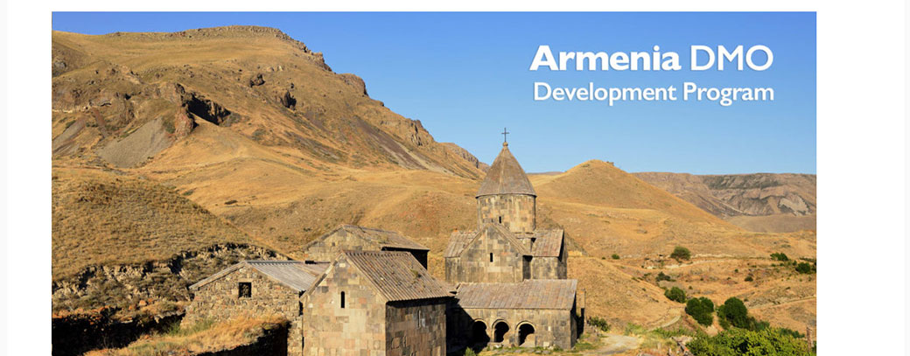
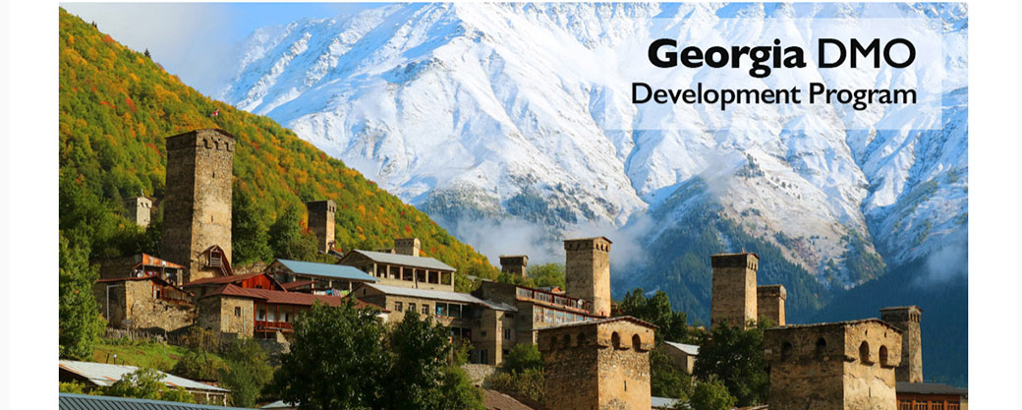
DMO Development
The right Choice to solve complex issues in Tourism Ecosystems

Slide 7
DMO Development
Objectives | Potential Procedures
Creating the organizational conditions for long-term tourism development geared to adding value | Analyzing the status of organizational frameworks at the destination Initiating a participatory process to develop efficient DMO structures
Consolidating the tasks of development cooperation, thereby ensuring that interventions have a lasting impact | Analyzing the destination’s competitiveness EstablishingAccepted Standards
Target group: Public authorities at regional or national level, existing tourism organizations | Developing a destination management concept Implementing and strategically supporting the DMO

Slide 8
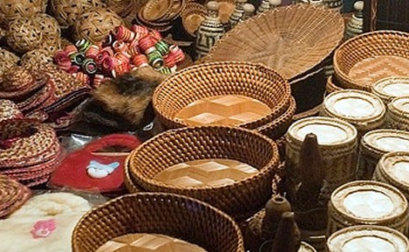
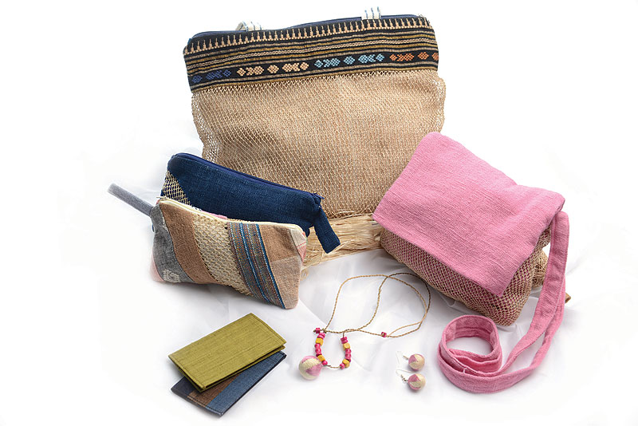
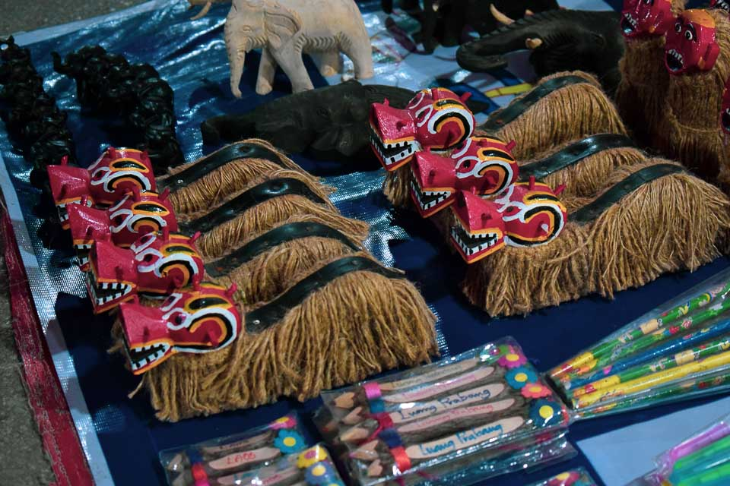
Integrating Stakeholders in the Value Creation System
Tradition
Handicrafts
Artifacts

Slide 9
Integrating Stakeholders in the Value Creation System
Objectives | Potential Procedures
Creating market access for SMEs from neighboring sectors | Market analysis of potentials and obstacles to cooperation between SMEs and tourism enterprises Weighing up the opportunities and risks posed by cooperation arrangements
Increasing value added by integrating regional companies into the tourism value creation system | Identifying strategies to tap the market, e .g . end customer strategy or business-to-business strategy Possible solutions, e .g . tailoring the product to market requirements or combining marketing activities for providers
Target group: SMEs from neighboring sectors such as agriculture and crafts, and tourism enterprises | Piloting solutions and evaluating their effectiveness Consolidating ongoing tasks by establishing organizational structures and designing processes Transferring successful solutions

Slide 10
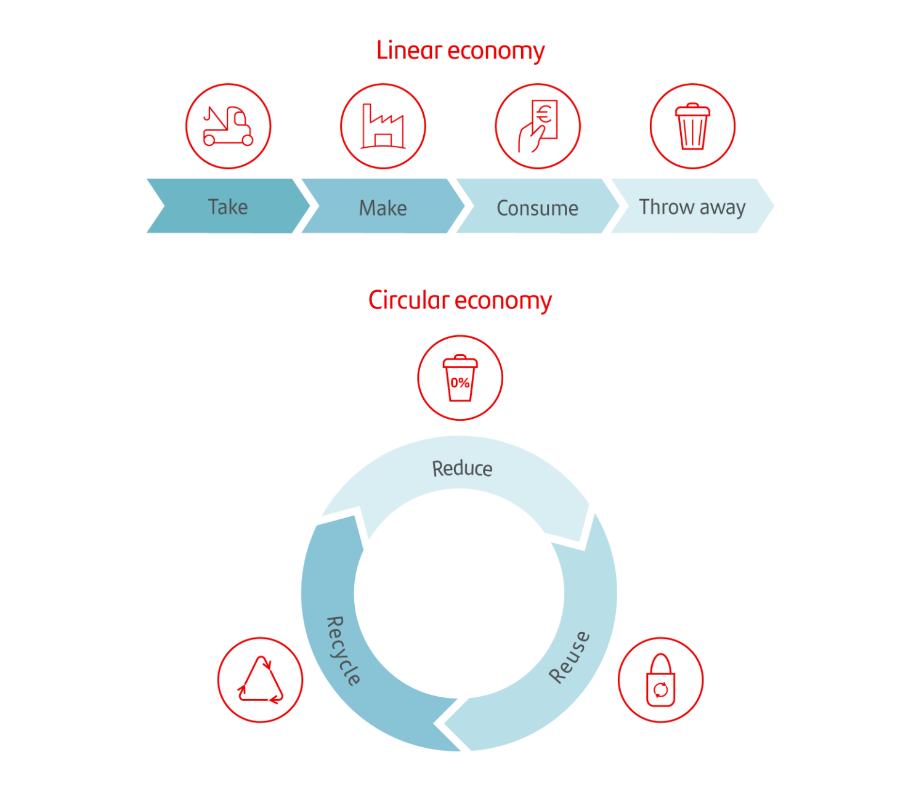
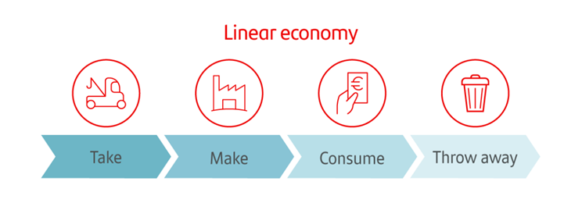
Circular Economy

Slide 11
Circular Economy
Objectives | Questions & Potential Procedures
Reducing resource consumption and emissions | Where can renewable raw materials and energy be used instead of finite resources? Which physical tourist goods can be made to last longer?
Increasing economic value added by creating new business models and thus generating employment | How can maintenance and repair extend the service life of physical goods used by tourism companies? How can physical goods be upcycled, reused or recycled?
Target group: Public authorities at regional or national level, existing tourism organizations, providers of tourism services, potential start-ups | Identifying and assessing business and project ideas for implementing the circular economy in tourism Promoting business ideas and implementing and evaluating (model) projects

Slide 12

Developing the supply chain in line with socio-cultural & environmental criteria
Methodology that keeps meaningful priorities

Slide 13
Developing the supply chain in line with socio-cultural & environmental criteria
Objectives | Potential Procedures
Minimizing the environmental burden of tourism | Analyzing the environmental impact (e .g . resource consumption, CO2 emissions, waste production) along the value chain Analyzing the socio-cultural impacts (e .g . number of employees, percentage of women employed, wage level) of the services along the tourism value chain
Optimizing the socio-cultural impacts of tourism | Identifying and assessing the potential for optimization, e .g . at workshops with tourism companies
Target groups: public authorities at regional or national level, municipalities, existing tourism organizations | Developing solutions, ideally based on the market economy Supporting the implementation of solutions, possibly as part of model projects

Slide 14


Integrating Digital Transformation
Advanced Technologies – Digitalization – AI/VR/AR

Slide 15
Integrating Digital Transformation
Objectives | Potential Procedures
Enhancing guest satisfaction by improving the availability of data on the tourism services offered | Status analysis related to digitalization (what is the status quo of the destination and of the service providers?)
Increasing turnover from tourism by professionalizing digital marketing | Determining the need for action in terms of training and data infrastructure, digital products (e .g . apps) and digital marketing tools (e .g . stakeholder platforms)
Target group: Tourism organizations, tourism companies | Planning and implementing targeted measures in cooperation with the actors

Slide 16
Q & A
Thank You!

