Slide 1
Sustainable & Smart Tourism
Training Program
Organized by Mekong Institute (MI)
Funded by Mekong – Korea Cooperation Fund (MKCF)
November 2023

Slide 2
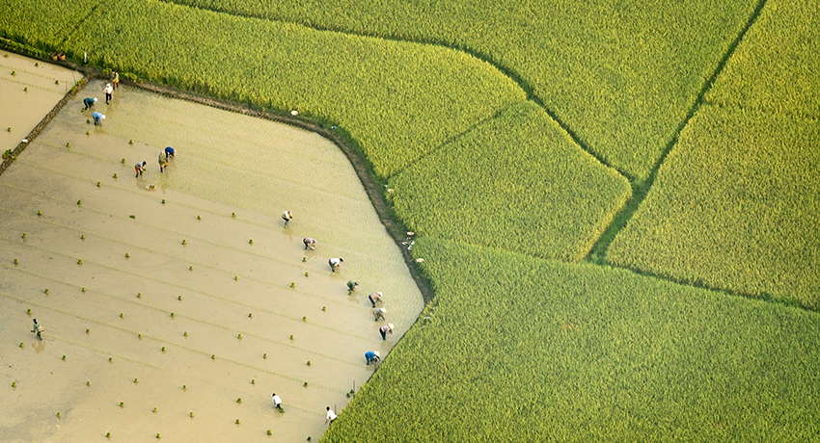


Understanding the Tourism Value Chain and the Tourism Ecosystem through System Thinking
MODULE 1
Trainer
November 2023

Slide 3
How to use Value Chain in the Tourism Sector
Session 3
Monday

Slide 4
Defining the Value Chain
Initiating Value Networks
Analyzing the Value Chain
Defining Objectives and Developing Solutions

Slide 5
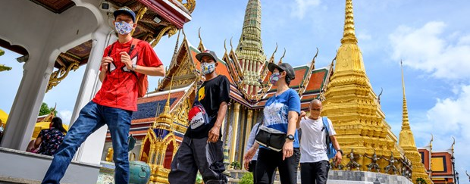

Defining the Value Chain
What are the core resources and values within our ecosystem for the last 100 years?

Slide 6
The start and the end of the Value Chain
What is our current business and economy status?
Are we all Happy with that?
Defining the Value Chain

Slide 7
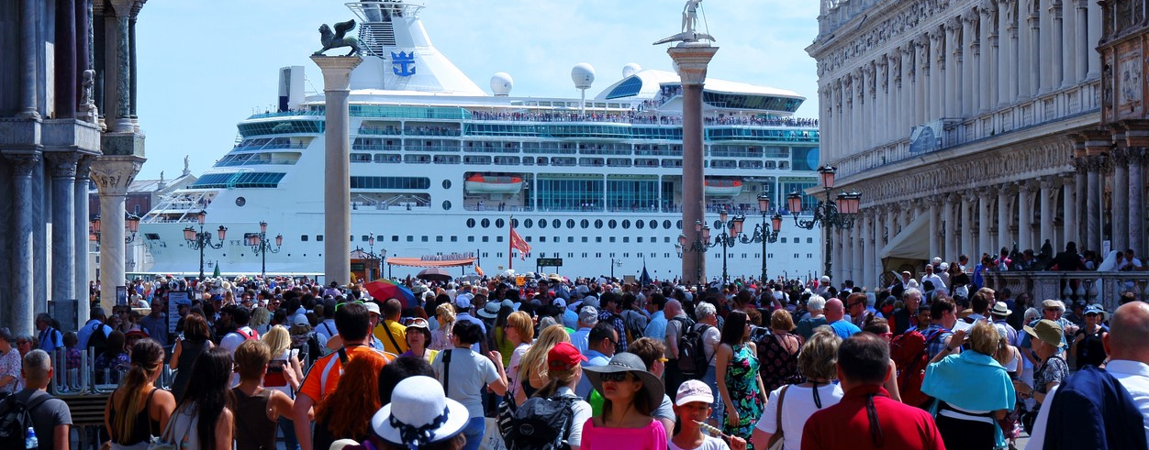
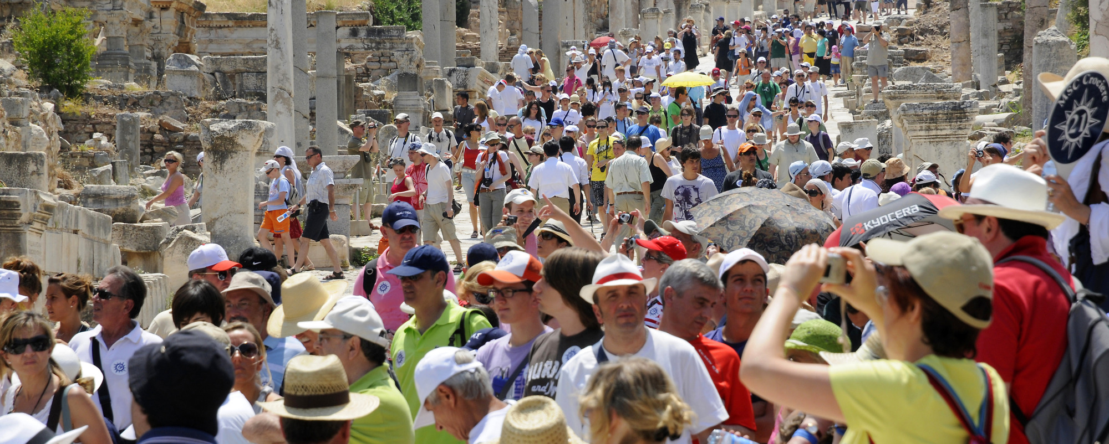
Defining the Value Chain
Is everybody Happy with what we have? Do we believe that our future is shiny?

Slide 8
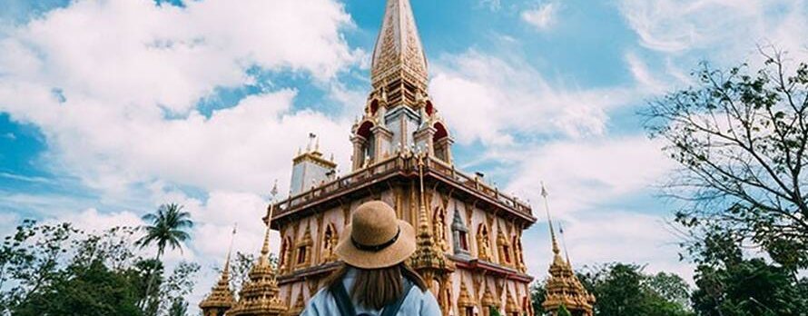
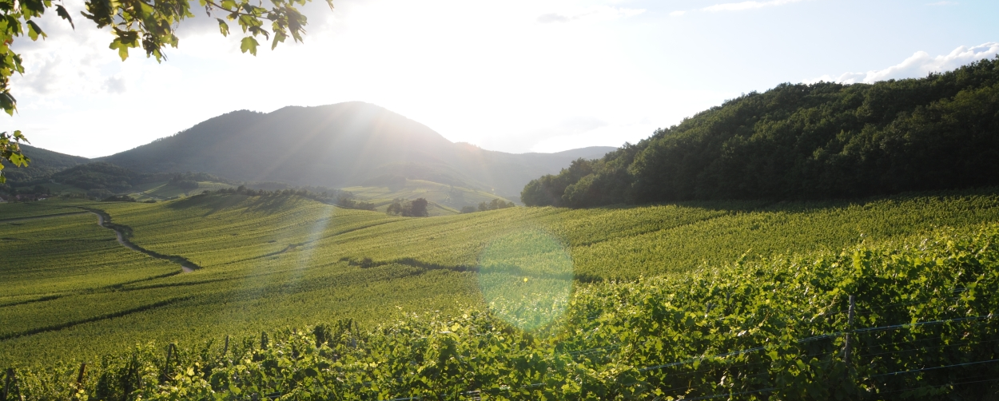
Defining the Value Chain
Is the current development and our status relying fully on those resources

Slide 9
Bring things together
Make the People feel proud of their Heritage
Create Authenticity within everybody’s daily life
Create meaningful stories for the community based on this authenticity
Design ways to engage visitors for unique experiences
Initiate Value Networks

Slide 10
Revitalize Resources and Values that faded
Make the People feel proud of their Heritage
Create Authenticity within everybody’s daily life
Create meaningful stories for the community based on this authenticity
Design ways to engage visitors for unique experiences
Holistic Approach
Analyzing the Value Chain

Slide 11
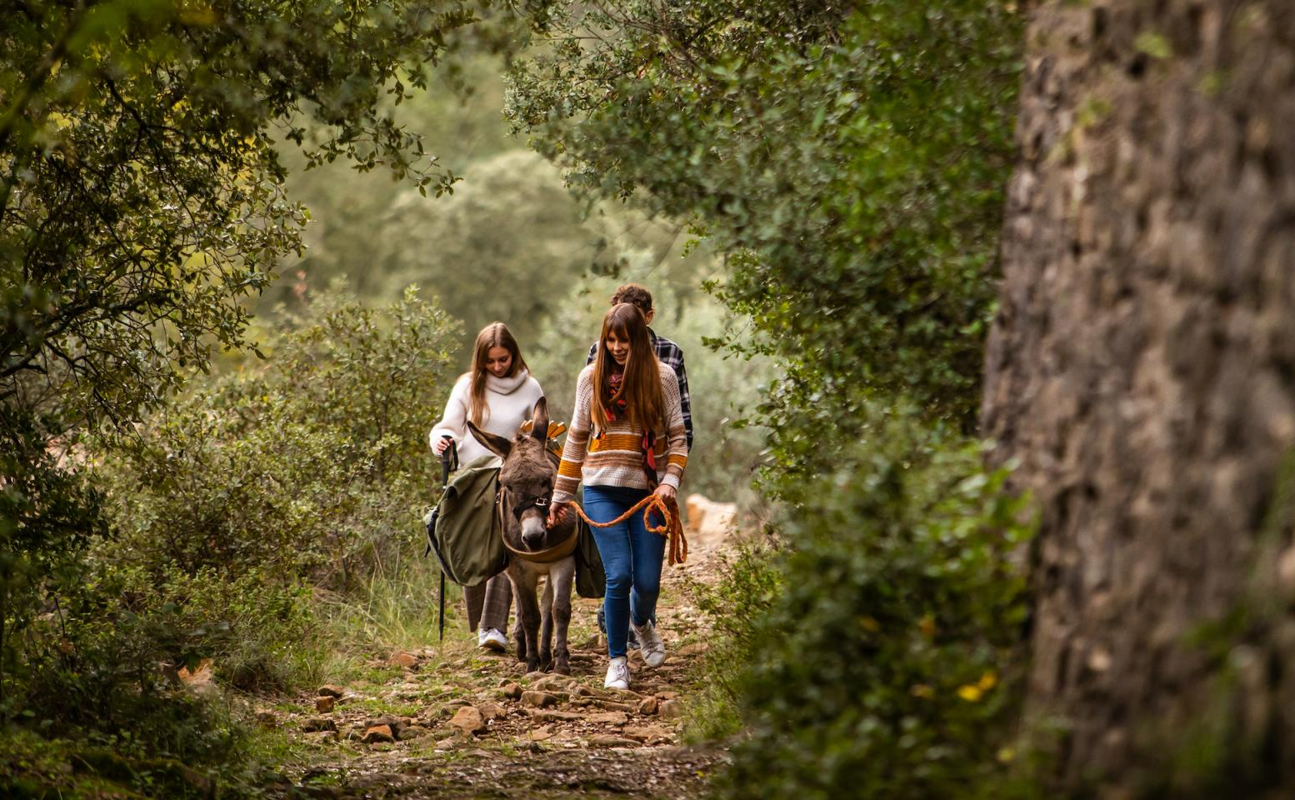
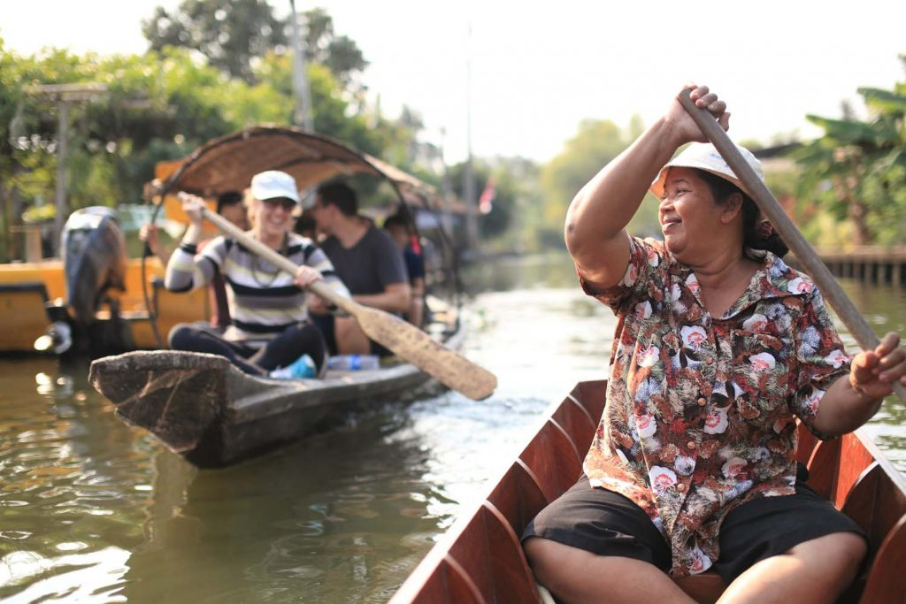
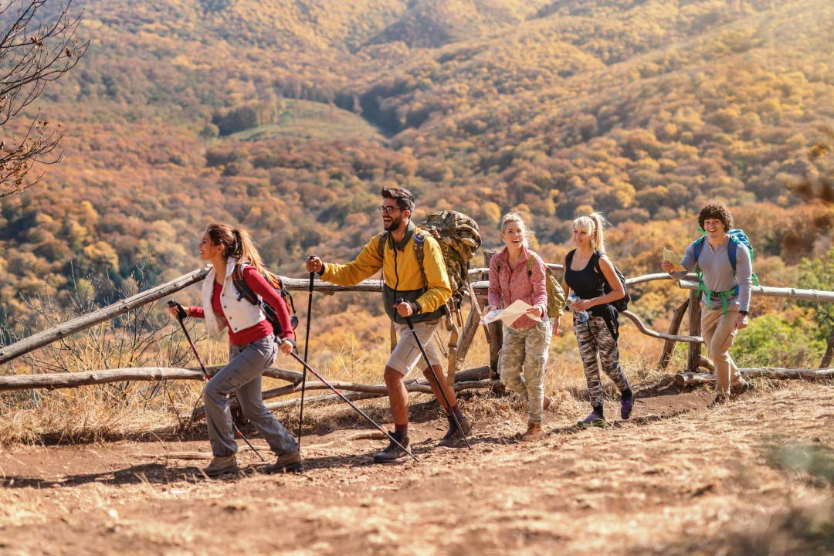
Initiating Value Networks
Natural
Social
Well-Being

Slide 12
Revitalize Resources and Values that faded
Make the People feel proud of their Heritage
Create Authenticity within everybody’s daily life
Create meaningful stories for the community based on this authenticity
Design ways to engage visitors for unique experiences
Holistic Approach
Analyzing the Value Chain

Slide 13
Analyzing the Value Chain
Area | ?
Adding Value | What we add and where Internal or External
Needs and Experiences | Expectations Areas of Improvement Accepted Standards
Communication | Reach Target Groups Channels
Area | ?
Conditions | Collaboration Level Synergies
Environmental Impacts | Waste-Pollution Wasted Resources Degradation
Socio-cultural Impacts | Employment Income Equality-Inclusivity

Slide 14
Each value network needs objectives to guide and motivate stakeholders. Objectives must be defined in a participatory manner with those actors who are to contribute to their achievement. This is the only way to define consensual objectives with which all stakeholders can identify.
Defining Objectives and Developing Solutions

Slide 15
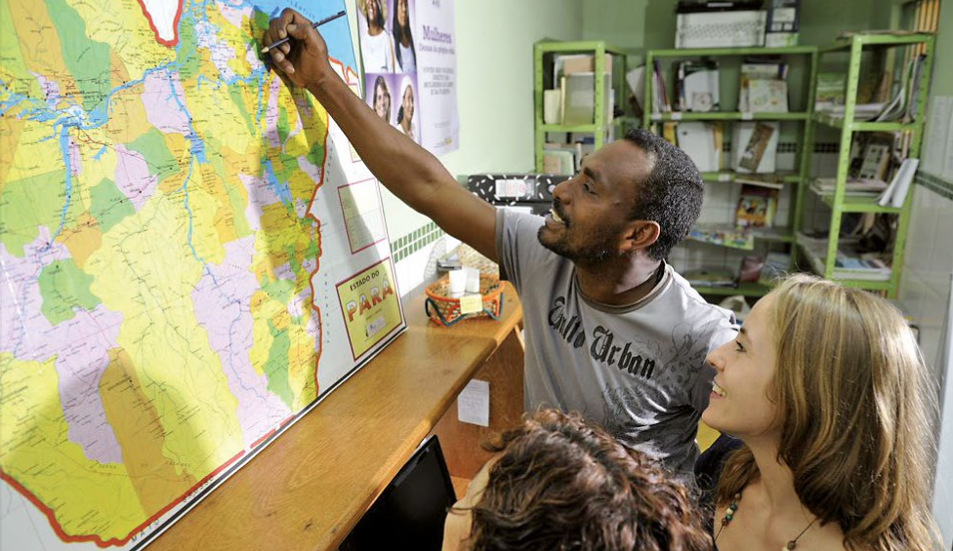
Defining Objectives and Developing Solutions
Objectives | Direction
Vision | Desired future for ALL Realisitc
Basic Principles | Sustainability Resilience Social Justice
Overarching Objectives | Bridge with Value Chain
Operational Objectives | Actions - Policies

Slide 16
Q & A
Thank You!

