Slide 1
Sustainable & Smart Tourism
Training Program
Organized by Mekong Institute (MI)
Funded by Mekong – Korea Cooperation Fund (MKCF)
November 2023

Slide 2



Understanding the Tourism Value Chain and the Tourism Ecosystem through System Thinking
MODULE 1
Trainer
November 2023

Slide 3
Introducing the Value Chain & Tourism (2)
Session 2
Monday

Slide 4
Tourism Services vs Tourism Experiences
Value-adding Strategies in the Tourism Sector
Innovation & Creativity in Tourism

Slide 5


Tourism Services vs Tourism Experiences
Skills, Training, Education, Products, Expertise

Slide 6
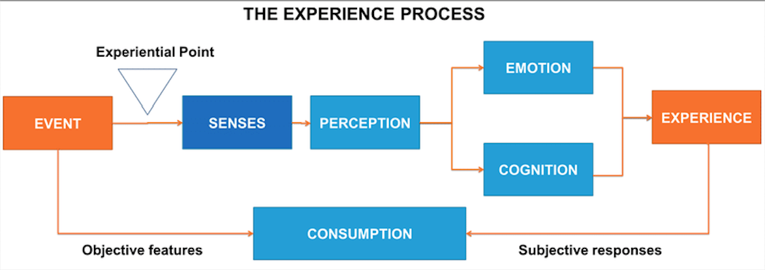
Tourism Services vs Tourism Experiences
Environmental

Slide 7
Tourism Services vs Tourism Experiences
Rigid
Standardized
One-way functional delivery
Lack of employee flexibility
Hyper-professionalism
Detached from tourism experience
Dynamic
Personalized
Cocreation of emotional values
Employee flexibility
Experiential Intelligence
Situated in integrated tourism experience environment

Slide 8
Services are OK but what about Experiences?
Experiences IN and OUT of our Service Environment
Follow the Guest and provide Experiences on the Spot
Serve the Senses not simply the Needs
Personalize – Customize – Cocreate
Tourism Services vs Tourism Experiences

Slide 9



Adding Value Strategies
Natural
Social
Well-Being

Slide 10
Adding Value Strategies
Less is More
Non-Tangible, Non-Economic values
The Sense of Inclusiveness and Contribution
Authenticity always adds more
Revitalize traditional values
Use technology to elevate experience not to impress

Slide 11


Innovation and Creativity in Tourism
In the 21st century, the tourism industry has undergone significant transformation, much of it driven by innovative technological solutions. With growing awareness of the environmental impacts of almost every economic sector, over the past five years technology has mainly been used to reduce costs, increase efficiency and advance sustainability.

Slide 12

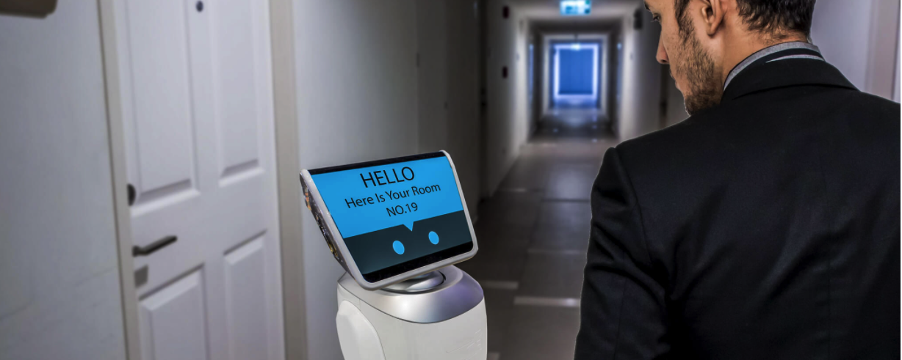
Innovation and Creativity in Tourism
Do things and provide services.
Faster, more efficient, higher productivity, increased safety and security, more health and hygiene, in a more sustainable way

Slide 13

Innovation Needs Creativity
Innovation and Creativity in Tourism
The hospitality industry has been putting an emphasis on innovation. Industry professionals are encouraging their staff and management to be creative with everyday practices and offerings for guests.

Slide 14
- Problem-solving skills
- Personal responsibility of tasks
- Openness to ideas and information
- Willingness to change and adapt
- Openness to new duties, roles or methods
- Interest in trying new things
- Facing challenges and uncertainty with optimism
- Able to question the status quo
Innovation and Creativity in Tourism
Creativity helps Tourism to
stay afloat and move forward

Slide 15
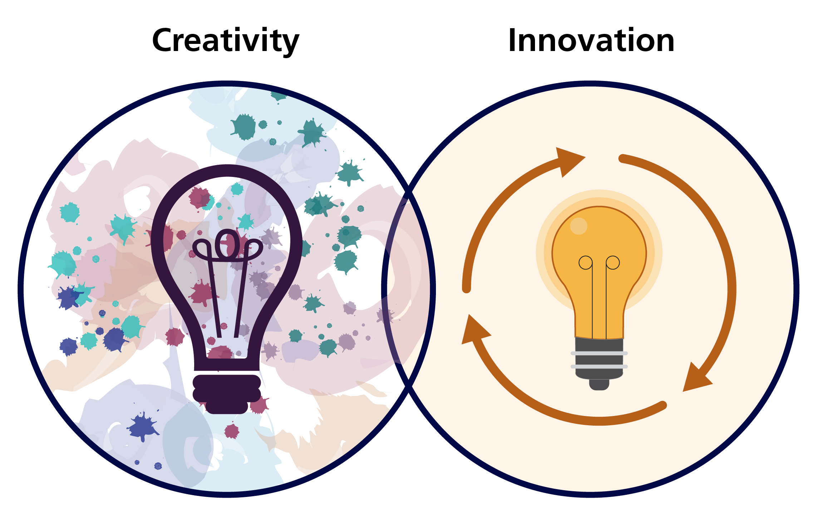
Creativity is valuable at all levels
Innovation and Creativity in Tourism
“If you’re a creative person, then you can find new angles and new ways to solve new problems.”

Slide 16
Q & A
Thank You!

