Slide 1
Sustainable & Smart Tourism
Training Program
Organized by Mekong Institute (MI)
Funded by Mekong – Korea Cooperation Fund (MKCF)
November 2023

Slide 2
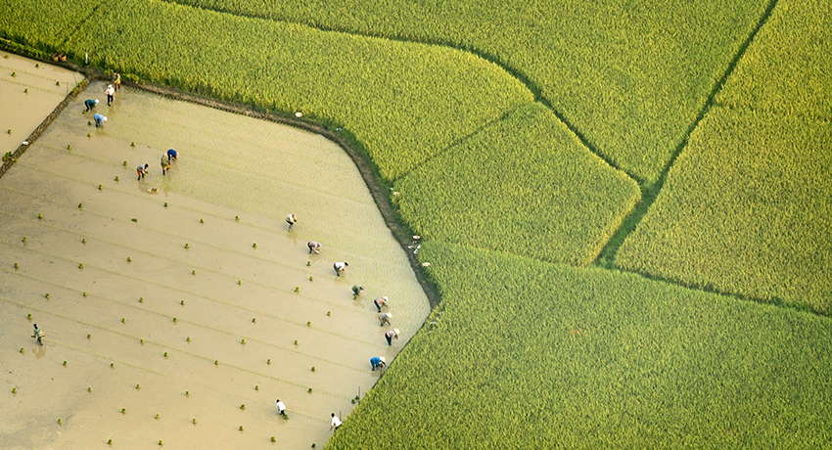
Understanding the Tourism Value Chain and the Tourism Ecosystem through System Thinking
MODULE 1
Trainer
November 2023

Slide 3
Introducing the Value Chain & Tourism (1)
Session 1
Monday

Slide 4
Regional value added as a Target
What you need to know about Value Chain
Tourism. What you need to know

Slide 5
Regional Value Added as a Target
Sociocultural
Environmental
Economic

Slide 6
Regional Characteristics – Place DNA
Authenticity
Cultural Heritage
Social Values

Slide 7
Identify what is important for the local communities. Look back in their roots. Analyze what happens nowadays in their daily lives. Create a common vision for a more holistic wellbeing. Focus on Continuity and Evolution.
Adding Value from existing Resources

Slide 8
Understanding Value Chain
VALUE CHAIN
=
ECONOMIC + SOCIAL + ENVIRONMENTAL VALUE

Slide 9
Understanding Value Chain
Strengthrning the Value Chain
Adding Value in Harmony with Environmental & Sociocultutal Criteria

Slide 10
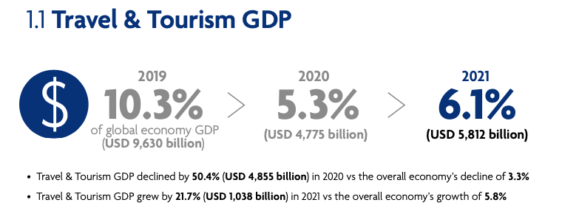
Fundamental aspects of Tourism
Tourism as a source of Development
Source:WTTC 2022

Slide 11
New Chapter for Tourism after the Pandemic
Fundamental aspects of Tourism
Consumers pay closer attention to their human impact on the environment and seek more sustainable options in how they live and travel.

Slide 12
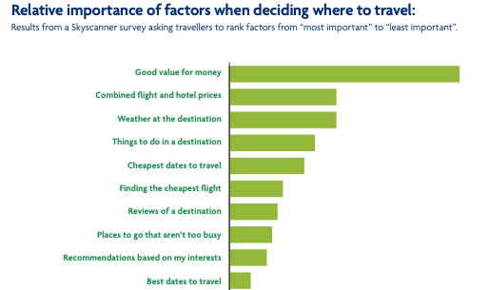
Fundamental aspects of Tourism
Changes on the Quality of Demand

Slide 13
Fundamental aspects of Tourism
Travelers’ desire to discover the world remains unabated, giving us hope for the future Tourism and its ability to make a meaningful difference to people’s lives and livelihoods.
Consumers along with the public and private sectors have a responsibility to continue to rebuild a more sustainable and inclusive Tourism sector for our people and planet.

Slide 14
Fundamental aspects of Tourism
The Challenge - Tourism Volume & Business Model
The Vision - Motivate travelers and all Stakeholders
The Goal – Tourism to create Value for ALL
The Outcome - A New Responsible Tourism Ecosystem

Slide 15
Q & A Thank You!

