Slide 1
Sustainable & Smart Tourism
Training Program
Organized by Mekong Institute (MI)
Funded by Mekong – Korea Cooperation Fund (MKCF)
November 2023

Slide 2

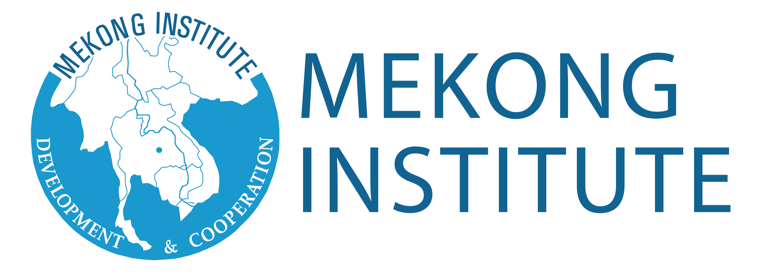

Developing Adaptive Capacities for Resilient Tourism Ecosystems.
MODULE 6
Trainer
November 2023

Slide 3
Social Change and Resilience. Application Difficulties and Solutions
Session 3
Monday

Slide 4
Explore the Application of CHANGE and Adaptive Capacities
Understanding Resistance to CHANGE
Motivation and Inspiration as Tools for CHANGES
Resilience as a Defense System

Slide 5

Explore the Application of CHANGE and Adaptive Capacities
Sustainable & Resilient Development policies increasingly focus on building capacities to respond to change (adaptation), and to drive change (innovation).
As CHANGE is a challenging task, adaptation abilities are essential to minimize the risks of negative impacts from the CHANGE process.

Slide 6

Explore the Application of CHANGE and Adaptive Capacities
Some potential challenges related to CHANGE are
- Lack of stakeholder support.
- No direction from management.
- Lack of funds.
- Inadequate members to do the work.
- Lack of governance and proper change management framework.
- Ambiguity about the need for change.
- Uncertainty or disbelief that the change could be positive

Slide 7
Explore the Application of CHANGE and Adaptive Capacities
Some potential challenges related to CHANGE are
- Lack of Clarity.
- Ineffective Change Communication. ...
- Strategic Shortcomings.
- Change Resistant Culture. ...
- Lack of Organizational Buy-In. ...
- Change Fatigue.

Slide 8

Understanding Resistance to CHANGE
Resistance to change is unwillingness to adapt to new circumstances or ways of doing things. It can happen with individuals, teams, or within organizations.
There are many reasons for resistance, but at its heart, resistance is rooted in fear of the unknown. People are biologically wired to look for patterns and predictability, and any uncertainty — even if it’s anticipated or positive — can trigger anxiety.

Slide 9

Understanding Resistance to CHANGE
Resistance to change is common and can come in many forms. It can be subtle or overt, and it can be seen in both individuals or groups of people.
Some examples might be missed meetings, sarcastic remarks, criticism, nitpicking, or even sabotage.
The good news is, no matter what form it manifests, overcoming resistance to change is possible. However, organizations need to first understand the causes of resistance to more effectively address it.

Slide 10
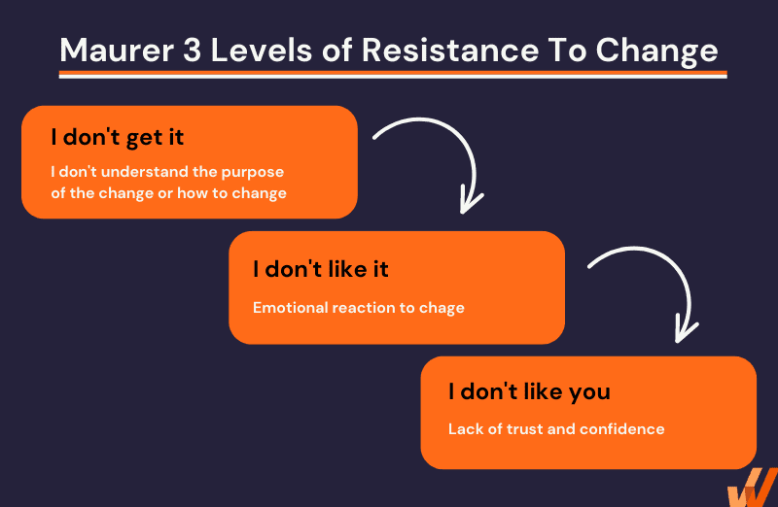
Understanding Resistance to CHANGE
Three Levels of Resistance
I don’t get it.
I don’t like it
I don’t like you

Slide 11
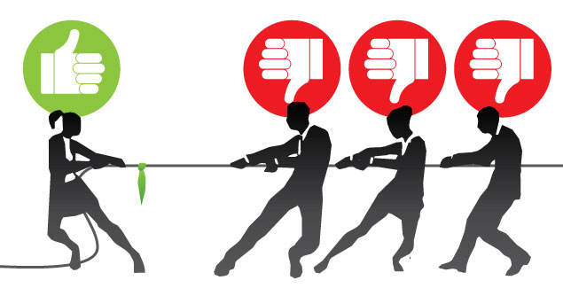
Understanding Resistance to CHANGE
To overcome resistance to change, communicate the benefits, involve stakeholders, provide support, and address concerns.
Create a clear vision and demonstrate the positive impact of the change to inspire acceptance and cooperation.

Slide 12

Motivation and Inspiration as Tools for CHANGE
If people are motivated towards change everything else becomes easier, they will:
- Easily develop and stick to a vision for change because more people can see themselves in the new situation and understand how it impacts them in an overall positive way.
- Seek to develop and hone their own change management skills, rather than wait to be sent to training they don’t actively engage with

Slide 13

Motivation and Inspiration as Tools for CHANGE
If people are motivated towards change everything else becomes easier, they will:
- More freely provide resources for change management rather than holding on to them to protect their own interests
- Create and execute Change Management plans easily because everyone is aligned and committed to delivering their assignments and sticking to deadlines.

Slide 14

Motivation and Inspiration as Tools for CHANGES
Inspiration is something that Leaders are able to do. The have the charisma to open new doors for attractive and realistic situations.
The are able to have a positive sentimental and psychological impact to people around them.
People start to feel additional energy and strong willingness.

Slide 15

Resilience as a Defense System
Resilience is a valuable concept when it comes to defending against external threats. It refers to an individual's or an organization's ability to withstand, adapt to, and recover from adversity and challenges.

Slide 16
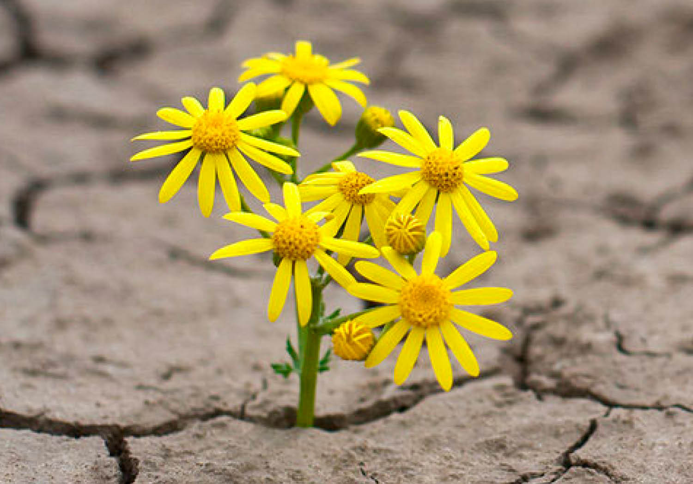
Resilience as a Defense System
Resilience is a critical strategy for defending against and responding to crises of all types, whether they are natural disasters, economic downturns, public health emergencies, or other unexpected challenges. Some ways to strengthen your resilience as a defense system.
- Crisis Preparedness
- Emotional and Psychological Resilience
- Community Resilience
- Economic Resilience

Slide 17

Resilience as a Defense System
Some ways to strengthen your resilience as a defense system.
- Education and Training
- Infrastructure Resilience
- Government and Policy Resilience
- Global Collaboration
- Adaptive Capacity

Slide 18
Discussion about potential CHANGEs in Mekong Region

Slide 19
Q & A
Thank You!

