Slide 1
Sustainable & Smart Tourism
Training Program
Organized by Mekong Institute (MI)
Funded by Mekong – Korea Cooperation Fund (MKCF)
November 2023

Slide 2
Smart Tourism & Sustainability
MODULE 5
Trainer
November 2023

Slide 3
Introduction to Smart Tourism
Session 1
Monday

Slide 4
Smart Tourism & Smart Destinations
The role of Technology
Smart Tourism Policies
Innovation and Creativity

Slide 5
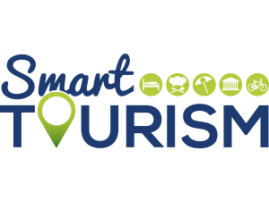
Smart Tourism & Smart Destinations
The aim of smart tourism is to develop information and communication infrastructure and capabilities to facilitate innovation, improve the visitor experience, and manage and collaboratively govern tourism more effectively (Gretzel et al., 2015).
The technologies that facilitate convergence have been identified as the major source of value creation, innovation and productivity for the future of tourism (APEC, 2019).

Slide 6
Smart Tourism & Smart Destinations
A smart destination is one with a strategy for technology, innovation, sustainability, accessibility and inclusivity along the entire tourism cycle: before, during and after the trip. A smart destination is also one with residents as well as tourists in mind, factoring multilingualism, cultural idiosyncrasies and seasonality into tourism planning.
This is why smart destinations are key to the transformation of the tourism sector. By continuously and accurately measuring, integrating and analyzing data for efficient decision-making, prioritization and anticipation of challenges, they create a seamless and exciting experience for tourists while managing local resources efficiently.

Slide 7
Smart Tourism & Smart Destinations
Smart destinations can make tourism governance more inclusive through inclusive entities, such as boards, trusts or foundations, which represent all public/private stakeholders in the destination. They can help ensure maximum accessibility in sites, products and services, eliminating barriers to mobility. And they allow us to analyse sustainable tourism management through different lenses.

Slide 8
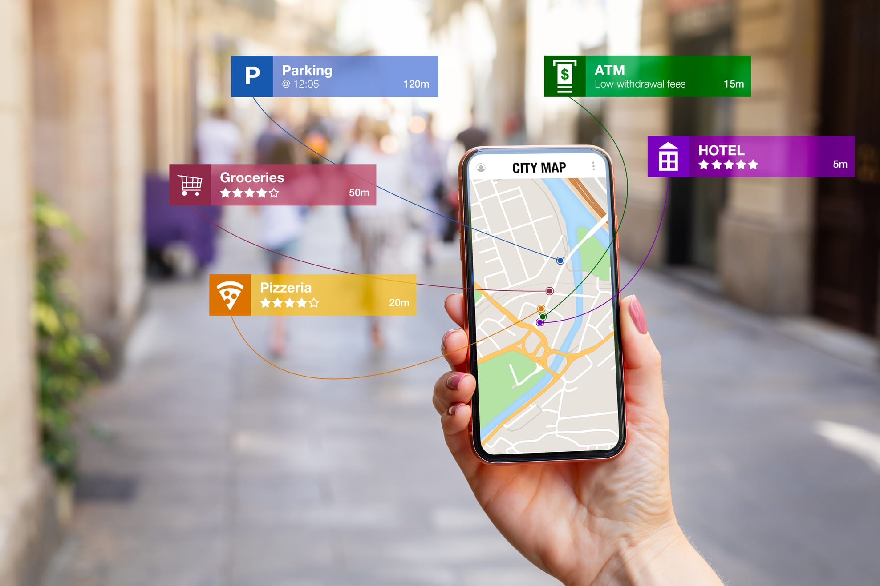
Smart Tourism & Smart Destinations
In tourism, digital-physical convergence is demonstrated by augmented reality, wearable technologies, and the Internet-of-Things to generate new hybrid products, services and experiences. Examples include e-bikes, e-scooters and e-cars which can be accessed anywhere, anytime with a mobile app, reducing the need for a front office presence and staff, to potentially be replaced by tech support and maintenance facilities. When scaled across cities, regions or a country, smart tourism development is possible.

Slide 9
The role of Technology
The evolution and application of digital technologies are profoundly changing the way people live, work, travel and do business, and in the process, they are transforming and reshaping tourism. The scope and uptake of digital technologies varies across countries, sectors, organisations and places.
The resulting opportunities and barriers create an uneven playing field, which is exacerbated by a growing gap between tech-driven and globally connected tourism businesses, and traditional micro and small businesses often characterised by low-tech business practices.

Slide 10
The role of Technology
Productivity-enhancing technologies (e.g. cloud computing, data analytics, revenue management software) have generally received low uptake in tourism, while innovative technologies (e.g. augmented reality, geotagging) are generating, customising and delivering in ever more novel ways, new visitor products, services and experiences (OECD, 2018c).
Digital transformation is thus pushing tourism in new and often unpredictable directions. Digital technologies have important implications for tourism businesses of all sizes, for the structure and operation of tourism value chains and for the sector as a whole.

Slide 11
The role of Technology
Digital Transformation.
Digitisation is the conversion of analogue data and processes into a machine-readable format, while digitalisation is the use of digital technologies and data as well as interconnection that results in new activities or changes to existing activities.
Digital transformation refers to the economic and societal effects of digitisation and digitalisation.

Slide 12
Smart Tourism Policies
To develop policies fit for the digital age, it is necessary to:
Be aware of the main elements of the evolving digital technology ecosystem and some of the opportunities (and challenges) resulting from their application.
2. Understand the data revolution that is taking place, and how data and data flows affect individuals, the economy and society more broadly, and
3. Identify the key properties of digital transformation, including how they are driving new and evolving business models, and what their implications are for public policy.

Slide 13
Smart Tourism Policies
Policies that support the development of business model innovation and regulatory systems that accommodate new business models and structures are important.
Business models have always been an important lever for growth, innovation and competitive advantage. To date, the digital transformation witnessed in tourism has been driven predominantly by new and innovative business models exploiting data analytics (i.e. by the digital natives turning data into intelligence), or through the adaptation and evolution of existing business models and value chains.

Slide 14
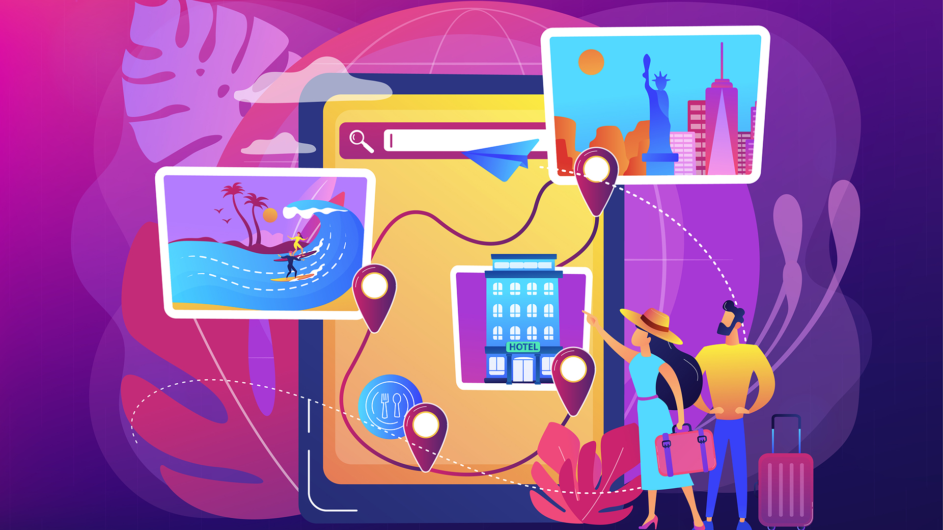
Smart Tourism Policies
The rapid pace of change in digital transformation has created challenges for policy makers. The existing policy environment and processes have struggled to keep up with rapid change and restructuring of business models and ecosystems, work, and global investment.
UNWTO (2019b) examined the challenges and complexity associated with enforcing existing rules and regulations in a review of new business models in the accommodation sector. The review highlighted that implementation is often hindered by lack of capacity, clear division of responsibilities and co-operation between the different responsible entities.

Slide 15
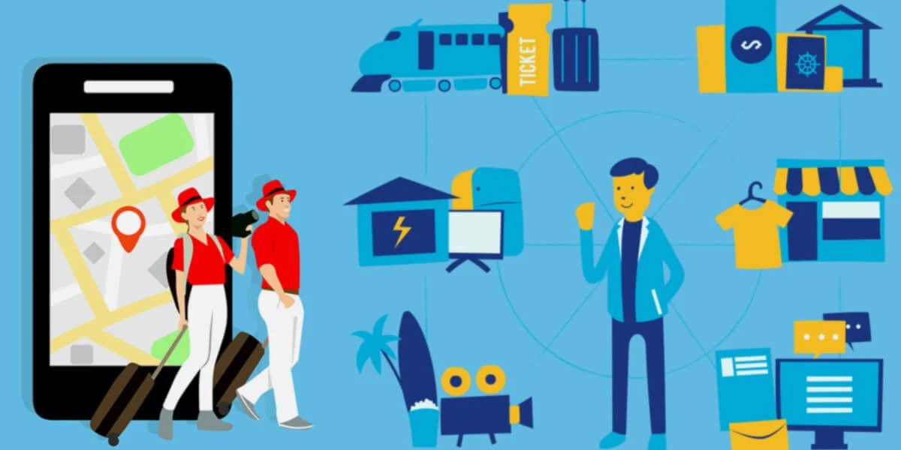
Smart Tourism Policies
Governments have an important role to play in creating the right framework conditions for the digital transformation of tourism business models and the wider tourism ecosystem. Integrated and coherent policy approaches are needed to leverage the opportunities of digitalisation while also addressing challenges and minimising any negative consequences that may emerge. Policy work can also be positioned across a spectrum of tourism businesses (e.g. digital natives, hybrids and tourism SMEs with low levels of digitalisation).

Slide 16
Innovation and Creativity
Tourism Innovation through Technologies
Mobile Technology/Cloud Computing
Data Analytics
Artificial Intelligence (AI)
Internet of Things (IoT)
Augmented Reality/Virtual Reality (AR/VR)
Blockchain
Robotics & Automation

Slide 17
Innovation and Creativity
Creativity helps Tourism Organizations to stay afloat and move forward
These creative characteristics include:
Problem-solving skills
Personal responsibility of tasks
Openness to ideas and information
Willingness to change and adapt
Openness to new duties, roles or methods
Interest in trying new things
Facing challenges and uncertainty with optimism
Able to question the status quo
Able to empathize with other people

Slide 18
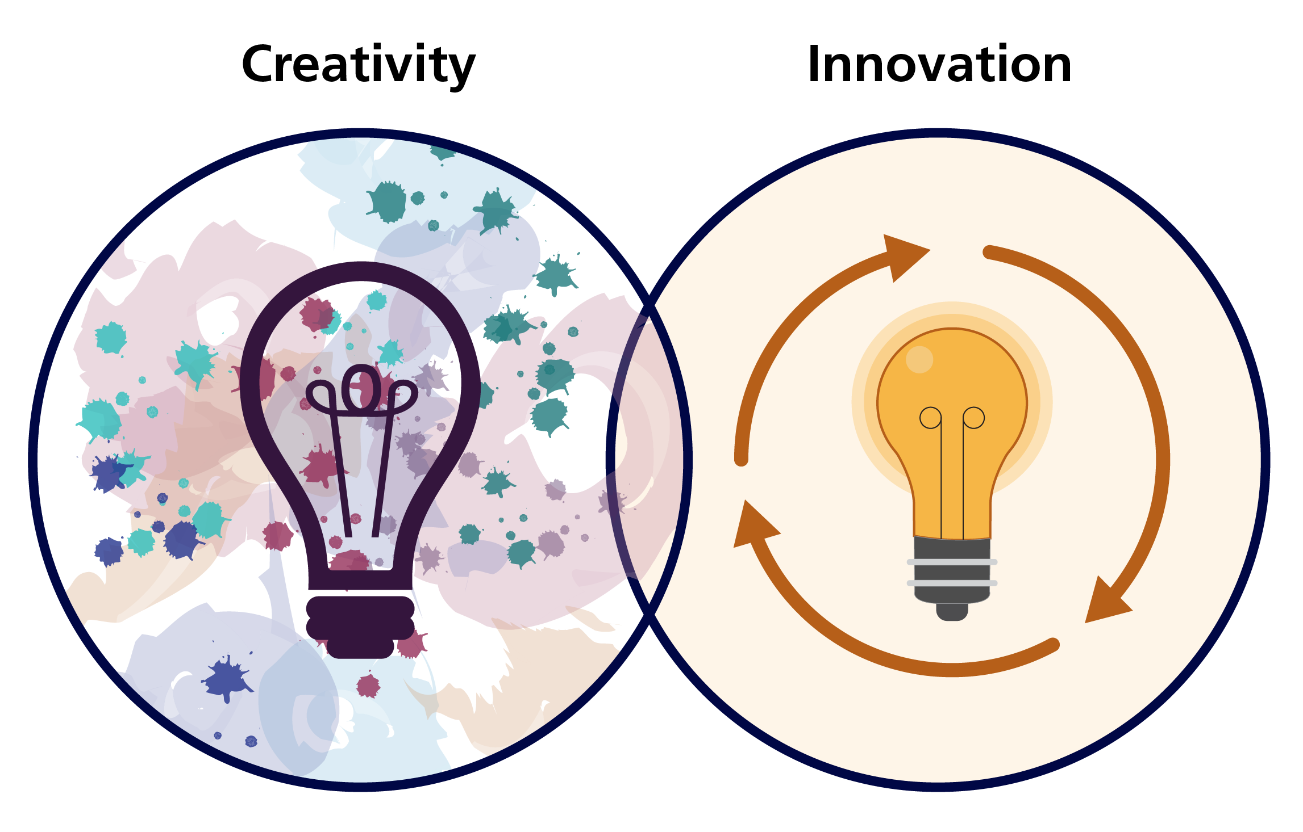
Innovation and Creativity
Innovation Needs Creativity
The hospitality industry has been putting an emphasis on innovation. Industry professionals are encouraging their staff and management to be creative with everyday practices and offerings for guests.
“If you’re a creative person, then you can find new angles and new ways to solve new problems.”

Slide 19
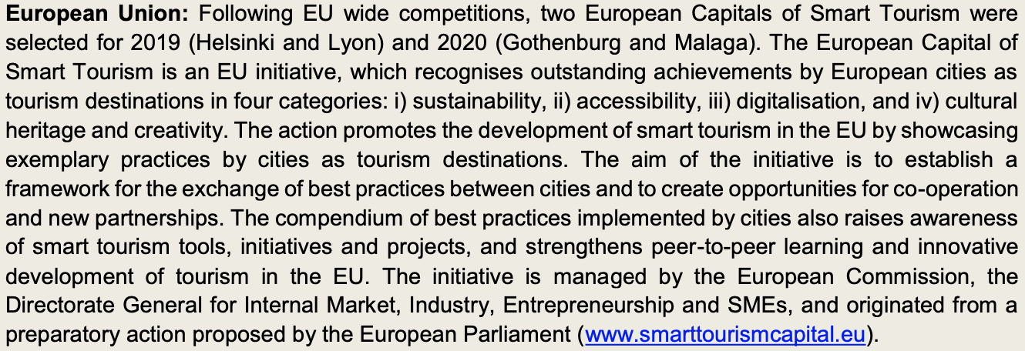
Examples of Smart Tourism in various Regions

Slide 20
Examples of Smart Tourism in various Regions

Slide 21
Discussion about Technology & Tourism in Mekong Region

Slide 22
Q & A Thank You!

