Slide 1
Sustainable & Smart Tourism
Training Program
Organized by Mekong Institute (MI)
Funded by Mekong – Korea Cooperation Fund (MKCF)
November 2023

Slide 2
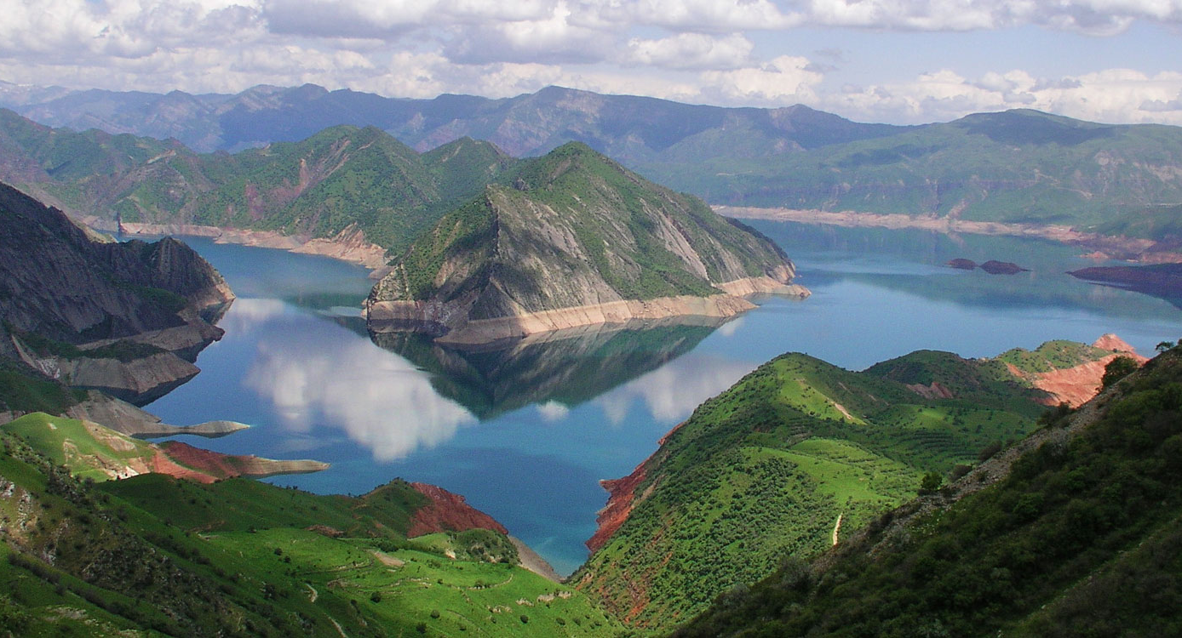


Sustainable Tourism Governance & Strategic Planning
MODULE 4
Trainer
November 2023

Slide 3
UNWTO and the International Network for Sustainable Tourism Observatories
INSTO
Session 3
Monday

Slide 4
UNWTO and INSTO
UNWTO Guidelines for measuring Sustainability
What needs to be done. Relativity of Data
Variety of Strategies for each Observatory
Reporting methods and examples

Slide 5


UNWTO & INSTO
The UNWTO International Network of Sustainable Tourism Observatories (INSTO) is a network of tourism observatories monitoring the economic, environmental and social impact of tourism at the destination level. The initiative is based on UNWTO’s long-standing commitment to the sustainable and resilient growth of the sector through measurement and monitoring, supporting the evidence-based management of tourism.

Slide 6
UNWTO & INSTO
INSTO seeks to support and connect destinations that are committed to regular monitoring of economic, environmental and social impacts of tourism, to unlock the power of evidence-based decision making at the destination-level, fostering sustainable tourism practices locally and globally.

Slide 7

UNWTO & INSTO
Since the establishment in 2004, a total of 38 observatories have joined the UNWTO INSTO Network: eight in China, one in Greece, two in Brazil, five in Indonesia, one in Croatia, one in the United States, one in Guatemala, one in Italy, one in Argentina, one in Australia, three in Portugal, six in Spain, two in Canada, one in Colombia, 3 in Mexico, and the last one to join us from Batanes, the Philippines.
https://www.unwto.org/insto/observatories/

Slide 8
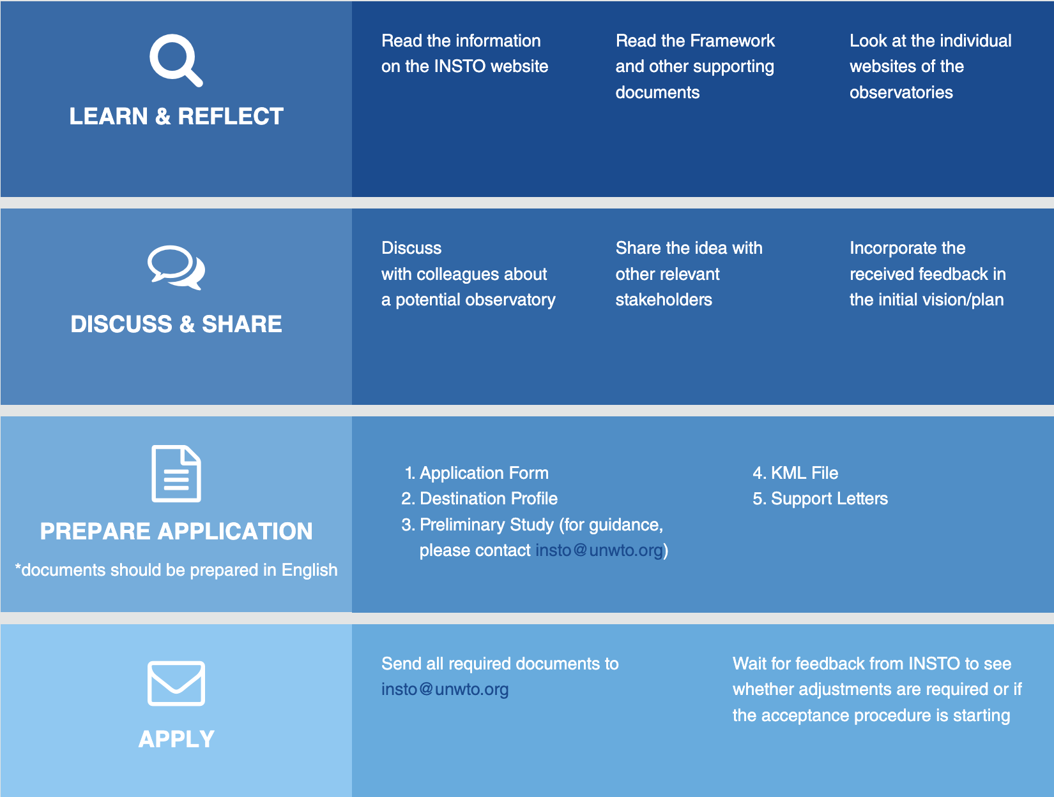
UNWTO & INSTO
How to join:

Slide 9
UNWTO Guidelines for Measuring Sustainability
Mandatory indicators pre-defined for 11 issue areas
Tourism Seasonality Employment Destination Economic Benefits Energy Management Water Management Waste (Sewage) Management | Solid Waste Management Climate Action Accessibility Local Satisfaction Governance

Slide 10
UNWTO Guidelines for Measuring Sustainability
Building awareness among local stakeholders
Why?
To build and strengthen common values and understanding
To ensure inclusiveness and transparency
Establishing and fostering a strong support system of facilitators
Why?
To build an efficient back-up system of relevant stakeholders (facilitators)
To allow for an extended promotion of the initiative, resource mobilization etc.

Slide 11
UNWTO Guidelines for Measuring Sustainability
Forming and engagement of a local working group
Why?
To ensure continuous commitment to regular monitoring
To establish continuous exchange and a leading body for reviews, discussions and decisions
Members: include members of all relevant stakeholder groups (private/public)

Slide 12

What Needs to be done. Relativity of Data
Pre-Establishing Stage
Acceptance Process
Documentation
Preliminary Study
Letter of Acceptance
Stakeholders Engagement

Slide 13
What Needs to be done. Relativity of Data
Observatories are encouraged to monitor additional destination-specific issue areas which are currently most relevant for their destination.
The additional destination-specific issue areas can be adjusted over time, depending on the needs of the destination, if necessary.
The data for the mandatory as well as destination-specific issue areas shall be collected and analyzed regularly.

Slide 14
What Needs to be done. Relativity of Data
As sustainability is context-sensitive, the role of indicators is to reflect the destinations’ priorities and needs.
While measurement should ensure comparability whenever useful among destinations and across levels, destinations are encouraged to use monitoring systems that include destination-specific indicators which correspond to their local requirements, context and subjective elements of perception, particularly with regards to the socio-cultural dimension.
Continuously advance the work on indicators and contribute to the discussion within the INSTO network and with interested institutions

Slide 15
Variety of Strategies for Observatories
Every Destination has a different strategy based on their own characteristics and according to the perceptions and awareness of the stakeholders.
Each observatory is different in its structure and focus.
Due to the context-sensitiveness of sustainability in general and the structures and characteristics of the destinations in specific, INSTO does not require members to specifically monitor pre-defined indicators, leaving enough flexibility in terms of the content and focusing more on the processes and innovative tools and techniques used by the destinations.

Slide 16
Variety of Strategies for Observatories
By becoming part of the INSTO, members accept the obligation to create and maintain a publicly accessible website for their observatory, including at least a summary in English.
The website has to be regularly updated, providing the newest data and analysis of monitoring results as well as information regarding the sources and methodology used. Before publishing online, monitoring results shall be consulted with the representatives of the Local Working Group.
Observatories are strongly encouraged to provide information on each of the indicators online (e.g. through a concise technical note).

Slide 17
Reporting Methods & Examples
An annual progress report on the issue areas and monitoring results shall be provided in English to UNWTO by each observatory.
It shall document and provide an overview of the monitoring activities for each issue area, the operations, performance and lessons identified of the calendar year and not exceed 15 pages.

Slide 18
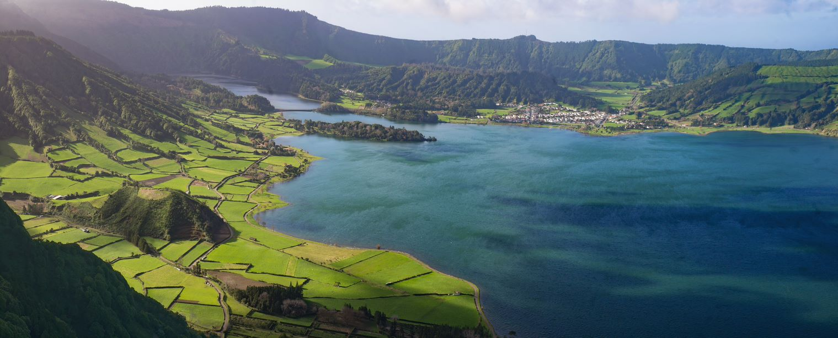
Reporting Methods & Examples
Azores Sustainable Tourism Observatory – 2020 Annual Activity Report
https://www.unwto.org/insto/wp-content/uploads/2023/05/2020-Annual-Activity-Report-of-the-Azores-Sustainable-Tourism-Observatory.pdf

Slide 19
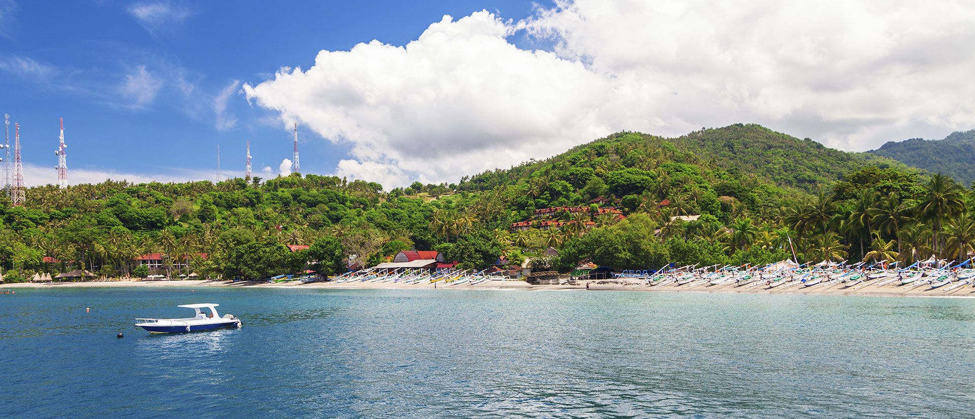
Reporting Methods & Examples
Lombok (Indonesia) Sustainable Tourism Observatory – Annual Activity Report
https://www.unwto.org/insto/wp-content/uploads/2023/05/2019-Annual-Report-of-the-Lombok-Sustainable-Toursism-Observatory.pdf

Slide 20
Discussion about possible Implementation in Mekong Region

Slide 21
Q & A
Thank You!

