Slide 1
Sustainable & Smart Tourism
Training Program
Organized by Mekong Institute (MI)
Funded by Mekong – Korea Cooperation Fund (MKCF)
November 2023

Slide 2



Frameworks for Monitoring Sustainable Tourism
MODULE 4
Trainer
November 2023

Slide 3
Monitoring Sustainable Tourism
Session 1
Monday

Slide 4
Reasons for Monitoring Sustainability
Methodological Approaches
Key Components of Measurement
Aligning with Sustainability Values

Slide 5


Reasons for Monitoring Sustainability
If you don’t MEASURE you cannot MANAGE
Sustainability includes a variety of sensitive Sociocultural, Economic and Environmental elements that we need to treat with a responsible way. We need to create solid evidence of the positive impact on these elements.

Slide 6


Reasons for Monitoring Sustainability
A holistic transformation of a destination aiming for the long-term prosperity of its people and its natural environment, transforming its tourism-based economy on the principles of sustainability. This transformation is based on specific measurable actions with a desired outcome that we need to monitor.

Slide 7

Reasons for Monitoring Sustainability
Benchmarking from other Sustainable and Smart Tourism Destinations
From a Strategy – To an Action Plan – To Measurable Outcomes

Slide 8

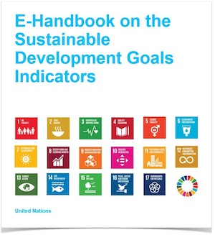
Methodological Approaches
Sustainability Indicators
Economic, Social and Environmental Balance
Data, Statistics and Indicators

Slide 9
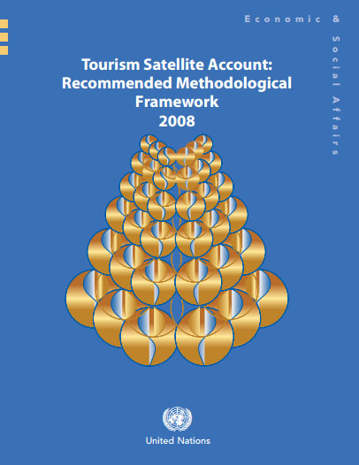

Methodological Approaches
  Methological Framework for the implementation of Tourism Satellite Accounts TSA (UN)
  UN – Tourism Satellite Account: Recommended Methodological Framework, 2008
Methodological Tools
  Implementation Guide for TSA in Europe
  Tourism Satellite Accounts in Europe, 2019

Slide 10
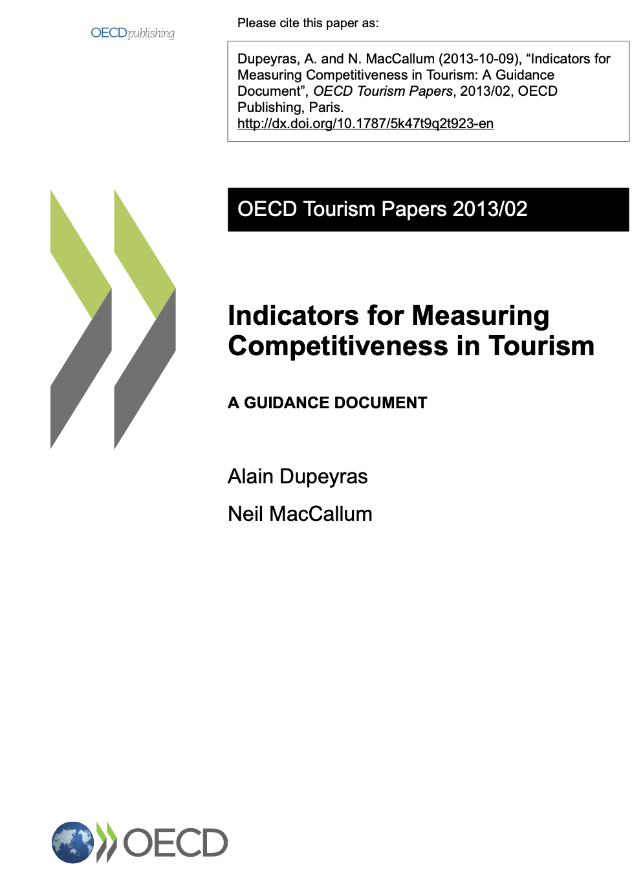
Methodological Approaches
Methodological Tools
  Indicators for Measuring Competitiveness in Tourism
  OECD Tourism Reports 2013/02

Slide 11
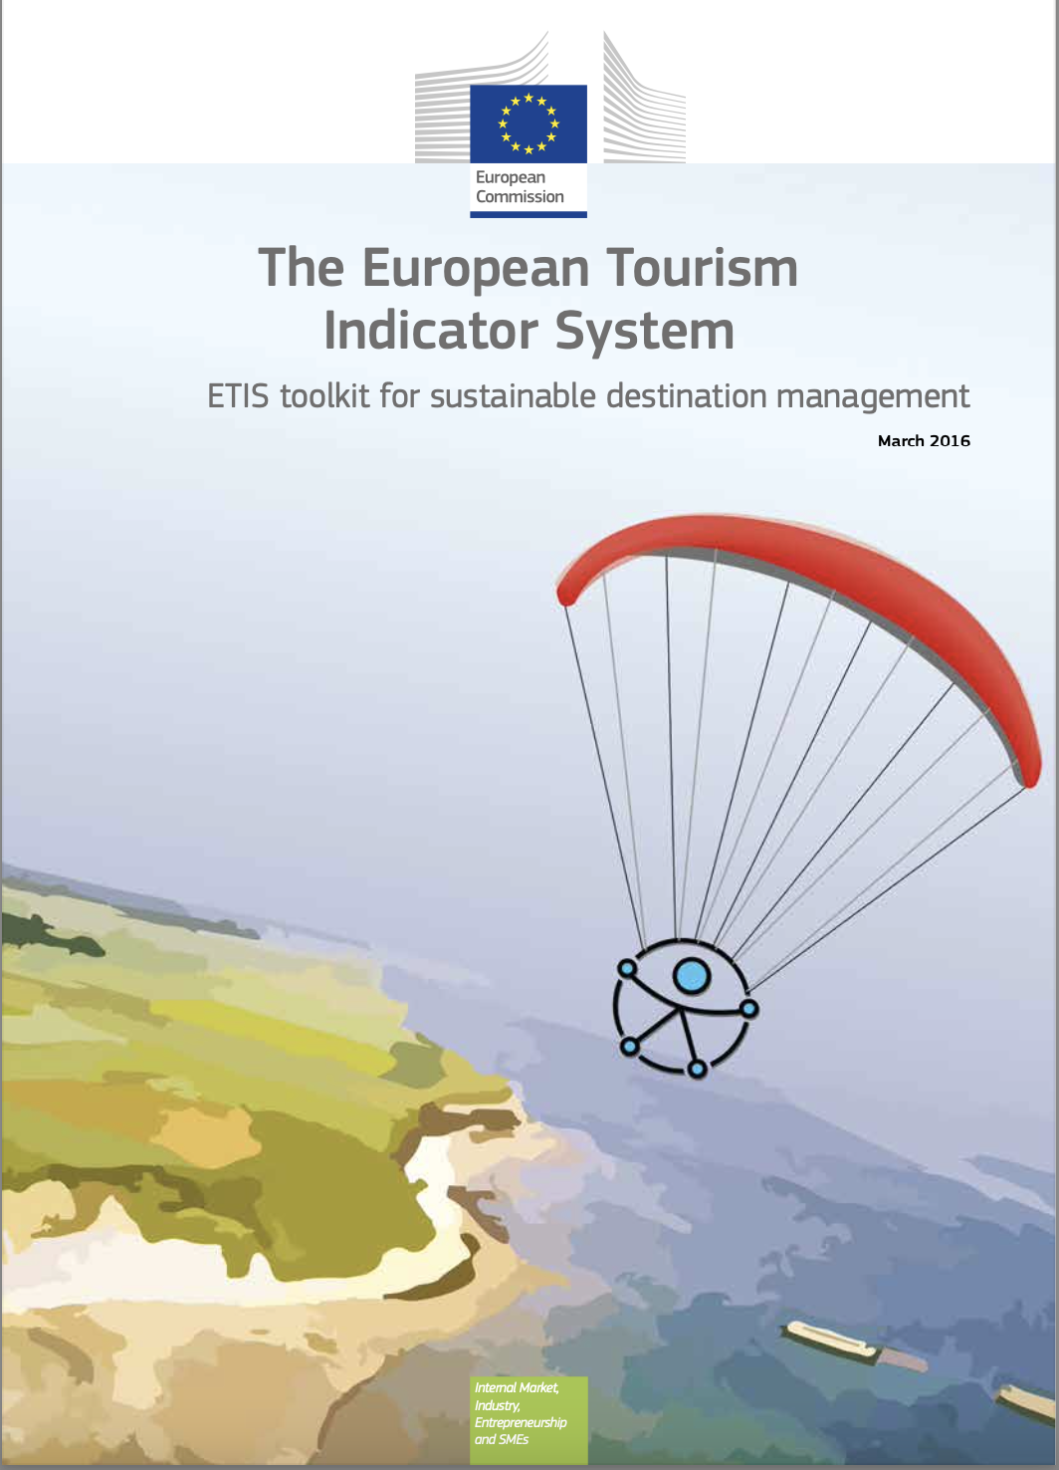
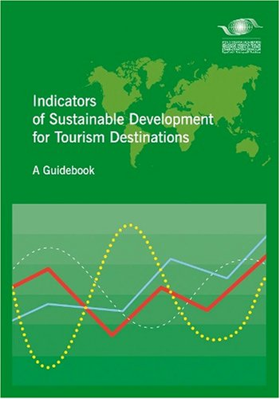
Methodological Approaches
Methodological Tools
  Indicators Toolkit from EU
  The European Tourism Indicator System – ETIS Toolkit
  for Sustainable Destination Management, 2016
  Indicators Guide from UNWTO
  Indicators of Sustainable development for Tourism Destinations
  – A Guidebook, 2004

Slide 12
Methodological Approaches
Methodological Tools
  Indicators Toolkit from EU
  The European Tourism Indicator System – ETIS Toolkit
  for Sustainable Destination Management, 2016
  Indicators Guide from UNWTO
  Indicators of Sustainable development for Tourism Destinations
  – A Guidebook, 2004

Slide 13
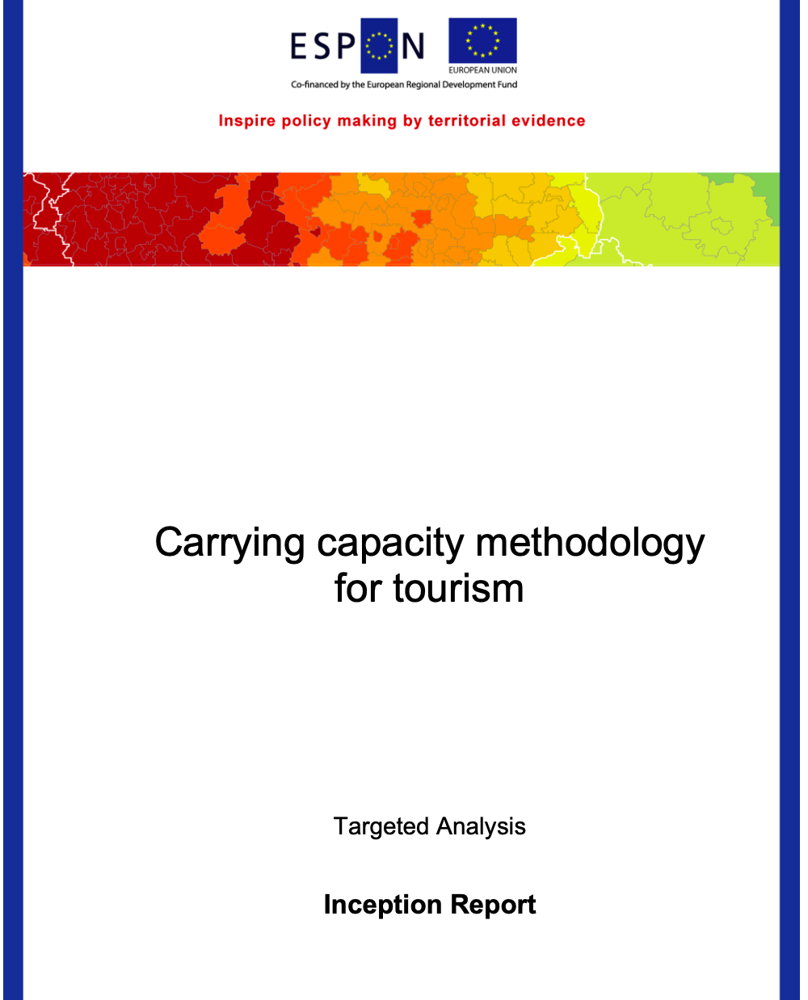
Methodological Approaches
Methodological Tools
  Evaluating Carrying Capacity
  Carrying Capacity Methodology for Tourism,
  (EU-ESPON, 2020)

Slide 14
Key Components of Measurement
  Examples of Key Measuring Areas
  Employment in Tourism
  Tourism Seasonality
  Managing Energy Sources
  Managing Water Sources
  Local Community’s Satisfaction Level
  Managing Liquid Waste
  Managing Solid Waste
  Governance
What we Measure?

Slide 15

Key Components of Measurement
Every place has its own needs and characteristics
Various issues can be considered more important regionally
All stakeholders need to agree to monitor these sensitive matters
Some scientific assistance is needed & consultation
International existing examples

Slide 16
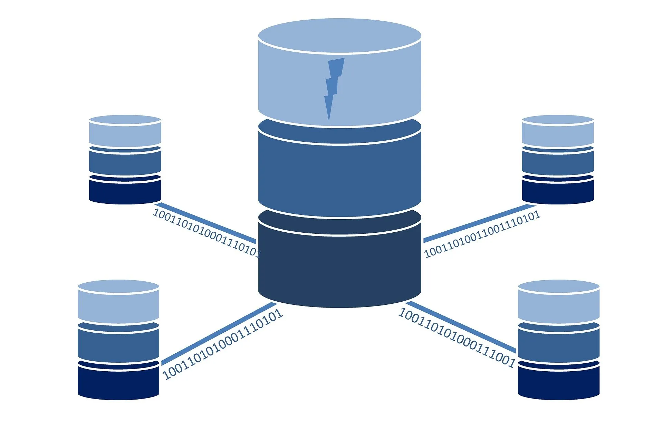
Key Components of Measurement
Data Selection process
Data Storing Process (Database)
Data Analysis & Calculations
Report Creation
Present Data and Outcomes with Scientific validity

Slide 17
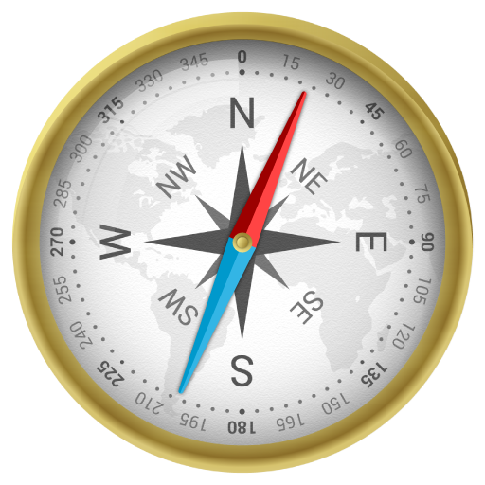

Key Components of Measurement
Selected Regional Statistics
Agreements for Access to Statistics & Data
Primary Research (e.g visitors’ satisfaction)
Developing a Regional Body to Manage the whole effort
Engage all those who will be interested to learn from the Data Analysis

Slide 18
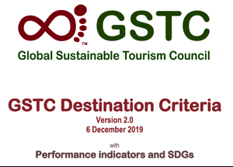
Aligning with Sustainability Values
UN SDGs
UNWTO
GSTC
Other Global Initiatives

Slide 19
Discussion about Monitoring Sustainable Tourism in Mekong Region

Slide 20
Q & A
Thank You!

