Slide 1
Sustainable & Smart Tourism
Training Program
Organized by Mekong Institute (MI)
Funded by Mekong – Korea Cooperation Fund (MKCF)
November 2023

Slide 2
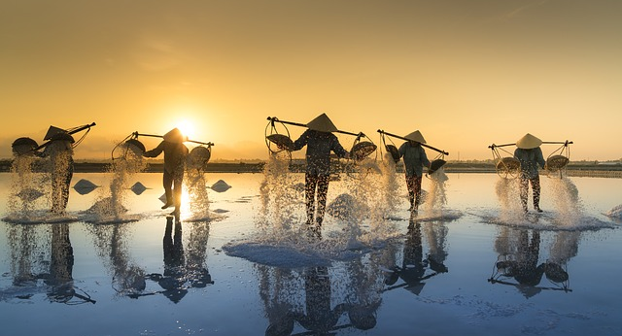
Sustainable Tourism Governance & Strategic Planning
MODULE 3
Trainer
November 2023

Slide 3
Strategic Planning & Policies Implementation Structured Learning Visit (SLV)
Session 4
Monday

Slide 4
SLV - Group Activity Structure and Deliverables
Understand the Destination – Key Resources
Sustainable and Smart Tourism Ideas
Proposed Action Plans
Groups Reporting and Presenting

Slide 5
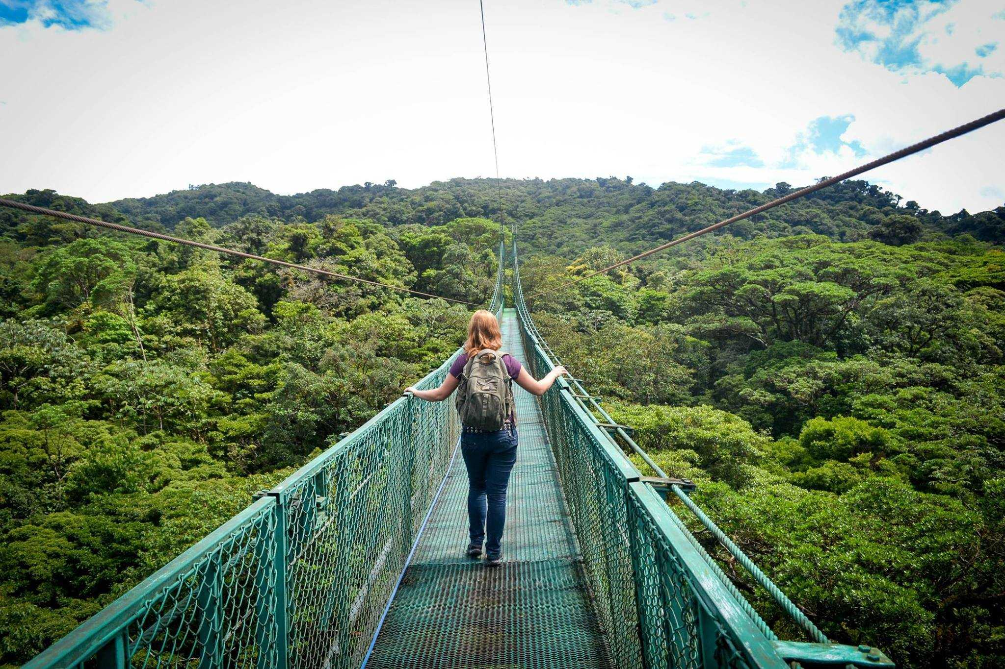
SLV - Group Activity Structure and Deliverables
Providing Essential Information to the 3 groups about their tasks
Observations
Keep Notes
Identifying Challenges

Slide 6
SLV - Group Activity Structure and Deliverables
Inspection Visit as a way to explore and analyze the local tourism ecosystem.
Holistic Approach and Overview.

Slide 7
Understand the Visited Destination-Location
What are the key elements, resources that are integrated in the destination.
Any hidden gems? What are the components of the Local DNA?

Slide 8
Understand the Visited Destination-Location
Can you describe the Identity of the Place?
What are the challenges that you identify from a first overview?
How their resources can contribute better for sustainable tourism?

Slide 9
Understand the Visited Destination-Location
Can you imagine a promising development plan?
What are the main Actions to be implemented?

Slide 10
Sustainable and Smart Tourism Ideas
Describe how Sustainability and Digital Leadership can create a new path for the Destination

Slide 11
Sustainable and Smart Tourism Ideas
Present 2-3 Ideas where selected resources with the use of technology can create a completive advantage with tangible outcomes that reflect to sustainability values

Slide 12
Sustainable and Smart Tourism Ideas
What will be the benefit of these Ideas
- To the locals
- To the Visitors
- To the local ecosystem

Slide 13
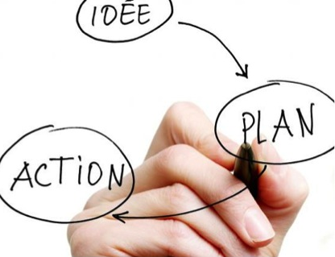
Proposed Action Plans
Describe Action Plans
Action Plan 1
Action Plan 2
Action Plan 3

Slide 14
Groups Reporting and Presenting
Prepare a Group Report including
- Concept
- Resources Evaluation
- Technology integration
- Sustainability Values served
- Action Plan Implementation
- Desired Outcomes
- Monitoring Process

Slide 15
Groups Reporting and Presenting
Prepare a Group Presentation including
- Concept
- Resources Evaluation
- Technology integration
- Sustainability Values served
- Action Plan Implementation
- Desired Outcomes
- Monitoring Process

Slide 16
Discussion about Group Reports

Slide 17
Q & A Thank You!

