Slide 1
Sustainable & Smart Tourism
Training Program
Organized by Mekong Institute (MI)
Funded by Mekong – Korea Cooperation Fund (MKCF)
November 2023

Slide 2
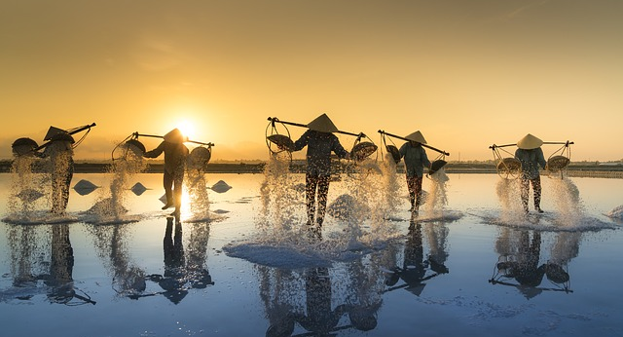
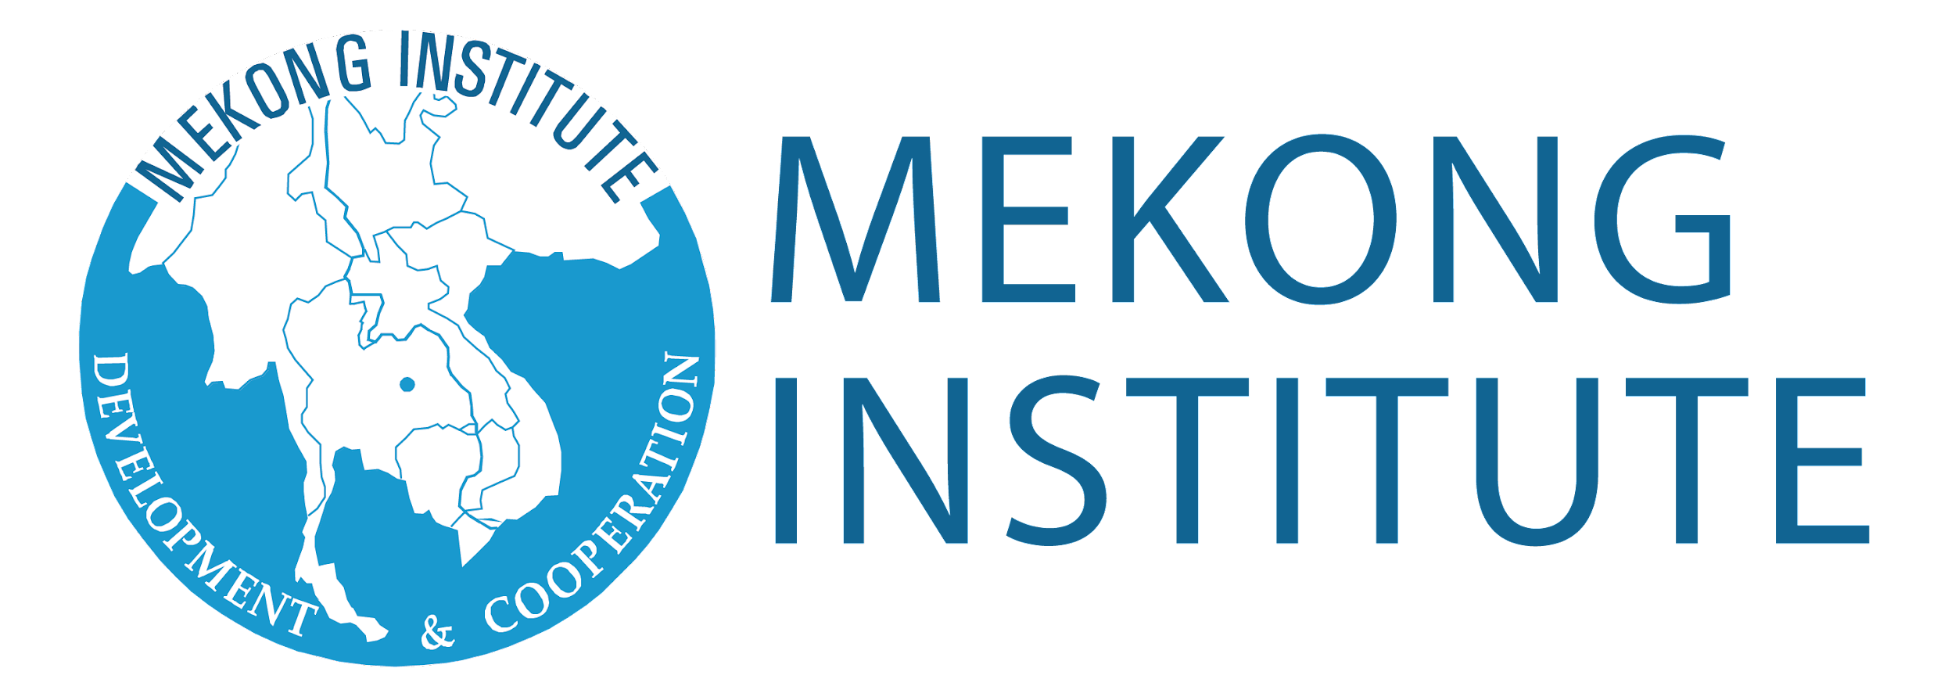

Sustainable Tourism Governance & Strategic Planning
MODULE 3
Trainer
November 2023

Slide 3
Introducing Sustainable Tourism Governance (2)
Session 2
Monday

Slide 4
How to Develop a Common Vision
Aligning different views to ONE Direction
Destination Leadership
Integrated Strategies

Slide 5

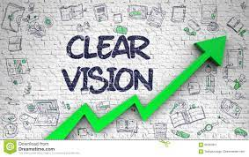
How to Develop a common Vision
As destination organizations globally are increasingly looking inward at stakeholders and residents, they’re addressing what organizational changes are needed to support a shared “social license” for tourism.

Slide 6


How to Develop a common Vision
Organizations sometimes have to navigate very opinionated stakeholders, who are clamoring for change (or even to stay the same!). This brings us to the first reluctant behavior that can emerge during the visioning phase: feeling threatened by strong, even contrarian opinions, even going so far as to avoid them by excluding certain people from the visioning process.

Slide 7

Align Different Views to ONE Direction
Sometimes you need to change mindsets and world view
From SMALL to BIG – From INDIVIDUAL to HOLISTIC

Slide 8

Align Different Views to ONE Direction
Some higher, ethical values are stronger that individual needs and wants.
Promote shared benefits – Not Individual Benefits

Slide 9
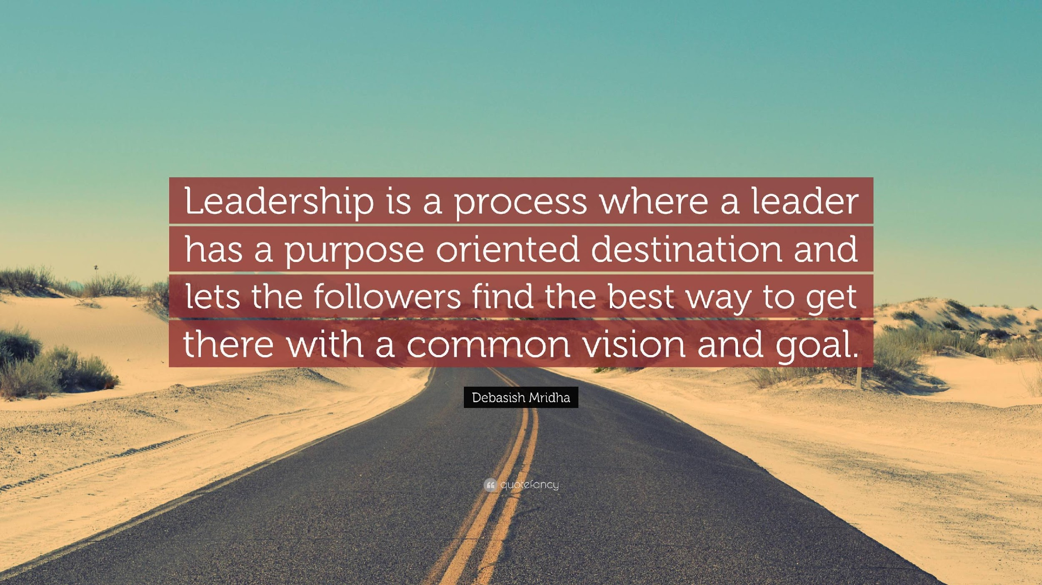
Destination Leadership

Slide 10

Destination Leadership
Setting a vision is a test of leadership in other ways.
During this part of the process we assess leadership strengths and weaknesses.

Slide 11

Destination Leadership
The visioning phase is critical for establishing the decision-making processes and structures that undergird the rest of the strategic planning process.
Leadership plays a Critical Role.

Slide 12

Destination Leadership
It’s very common to set a 10-year vision and then want to start implementing it immediately. But even after the vision is set, there’s still a lot of work to be done to establish what exactly the organization intends to do to implement that vision.
Leadership is important for the Implementation Phase

Slide 13
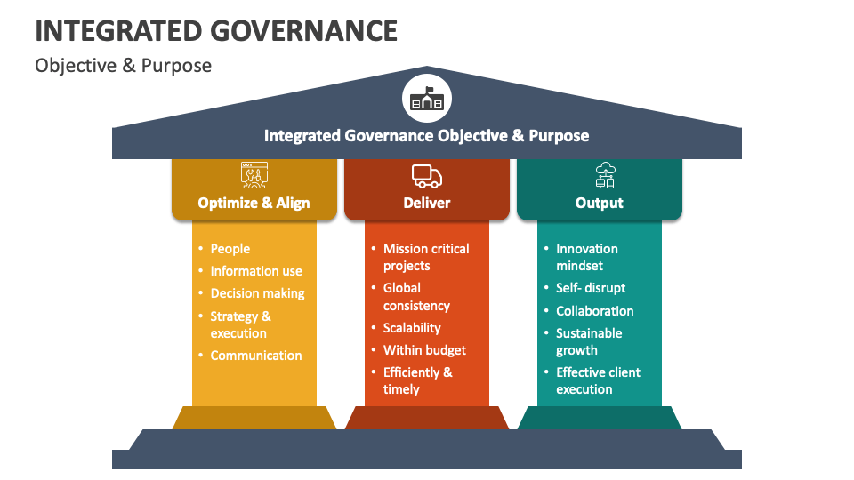
Integrated Governance Structures

Slide 14

Integrated Governance Structures
Understand all stakeholders
Identify their expected roles
Design Operational Mechanisms
Integrate Operational Units

Slide 15

Integrated Governance Structures
Allocate resources
Create balanced distribution of authority
Clarify Decision-Making Processes
Assign Objectives and Goals

Slide 16

Integrated Governance Structures
Describe the desired outcomes
Establish monitoring systems
Evaluate performance
Identify gaps and Modify

Slide 17
Discussion about Strategic Leadership

Slide 18
Q & A
Thank You!

